Slide 1
NEWMAZZ
2026 Product
Selection Manual
Industrial safety switches and guard locking devices
Shenzhen Newmazz Safety Technology Co., Ltd.
Making intelligent manufacturing safer
NEWMAZZ 2026
001
Notes:
Source: supplied NEWMAZZ 2026 Product Selection Manual. Cover.

Slide 2
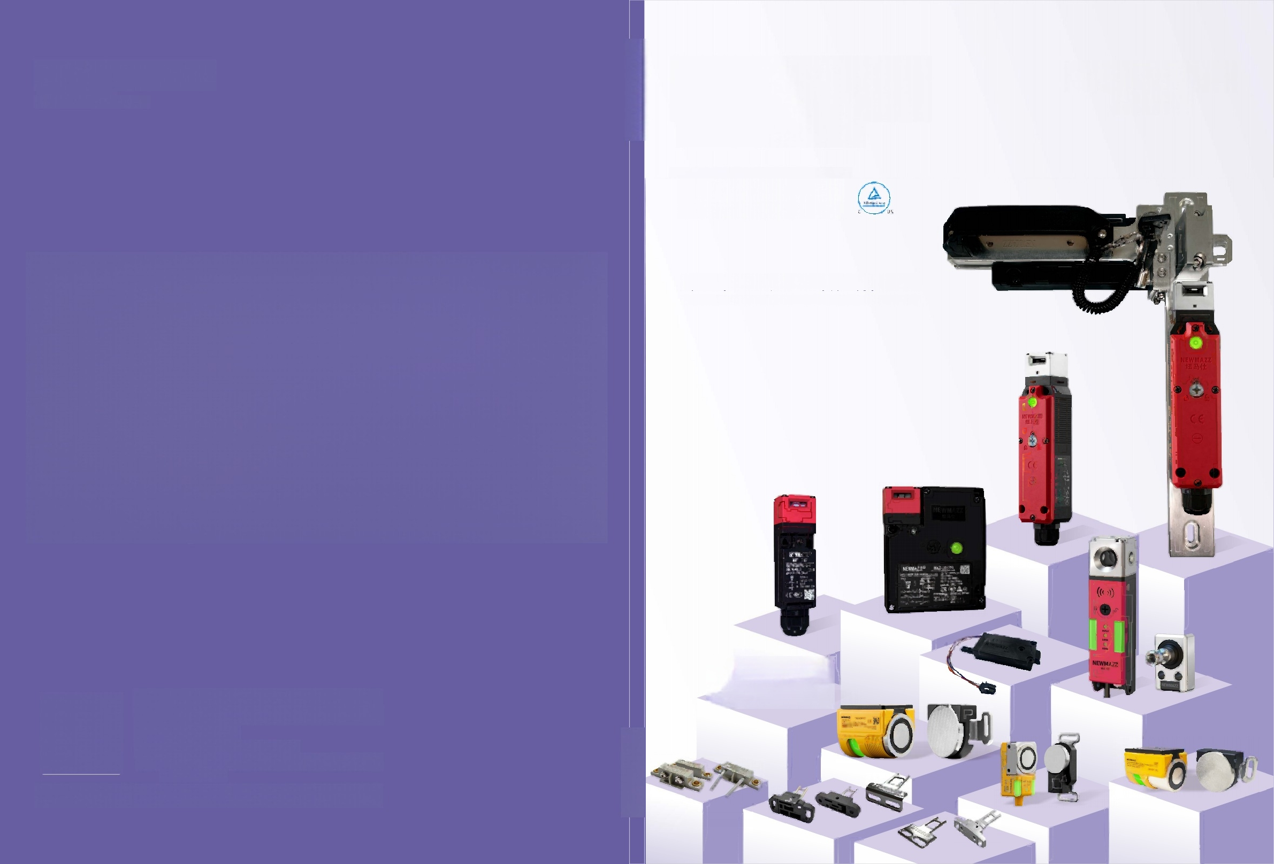
Company profile
NEWMAZZ integrates product and mold design, manufacturing, injection molding and assembly. The company develops, manufactures and sells industrial safety products.
Its products have independent intellectual property rights and serve guard doors in consumer electronics, semiconductors, medical equipment, new energy, machine tools, automotive, petrochemical, steel, electric power, water conservancy and wind power applications.
Customers have recognized these applications. NEWMAZZ focuses on industrial safety to improve intelligent manufacturing. Its professional team provides technical support and solutions.
NEWMAZZ industrial safety product range
NEWMAZZ 2026
002
Notes:
Source: supplied NEWMAZZ 2026 Product Selection Manual. Company profile, p. 01.

Slide 3
Company mission
Progress together in safety and pursue shared ambitions.
Work toward safe production around the world.
Put customers first and focus on safety products that support intelligent manufacturing.
Build a better working life and everyday life.
A specialist service provider in industrial safety.
Cooperation, shared success, innovation and development.
NEWMAZZ 2026
003
Notes:
Source: supplied NEWMAZZ 2026 Product Selection Manual. Company profile, p. 01.

Slide 4



Company certifications and honors 1
TÜV Rheinland mark
TÜV Rheinland certification mark
ISO mark
The company profile lists Chinese national certification, CE, CCC, TÜV Rheinland, SIL4, RoHS and UL. Individual product specifications list the applicable certifications for each series.
Certification statements reproduce the supplied manual. The certificate artwork contains very small text that is not fully legible in the source.
NEWMAZZ 2026
004
Notes:
Source: supplied NEWMAZZ 2026 Product Selection Manual. Company honors, p. 02.
Certification statements reproduce the supplied manual. The certificate artwork contains very small text that is not fully legible in the source.

Slide 5
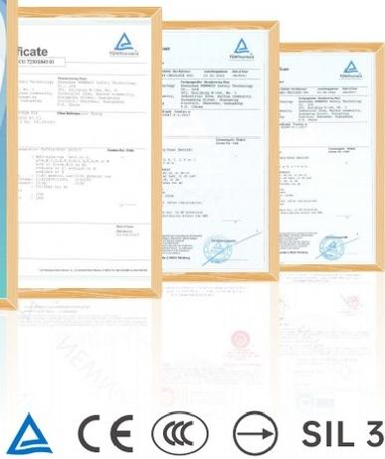
Company certifications and honors 2
The company profile lists Chinese national certification, CE, CCC, TÜV Rheinland, SIL4, RoHS and UL. Individual product specifications list the applicable certifications for each series.
Certificates and safety marks shown in the source
Certification statements reproduce the supplied manual. The certificate artwork contains very small text that is not fully legible in the source.
NEWMAZZ 2026
005
Notes:
Source: supplied NEWMAZZ 2026 Product Selection Manual. Company honors, p. 02.
Certification statements reproduce the supplied manual. The certificate artwork contains very small text that is not fully legible in the source.

Slide 6
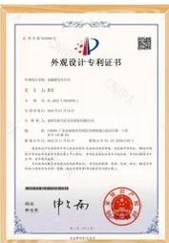
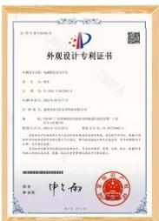
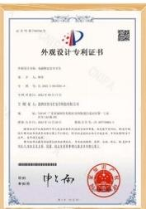
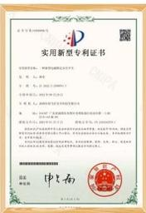
Patent and certificate gallery 1
Utility model patent certificate
Design patent certificate
Design patent certificate
Utility model patent certificate
Original certificate images. The small certificate text cannot be reliably transcribed at the supplied resolution.
NEWMAZZ 2026
006
Notes:
Source: supplied NEWMAZZ 2026 Product Selection Manual. Company honors, p. 02.
Original certificate images. The small certificate text cannot be reliably transcribed at the supplied resolution.

Slide 7
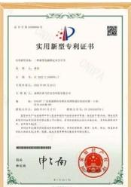
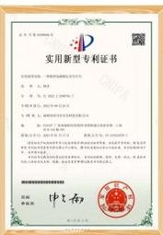
Patent and certificate gallery 2
Utility model patent certificate
Utility model patent certificate
Original certificate images. The small certificate text cannot be reliably transcribed at the supplied resolution.
NEWMAZZ 2026
007
Notes:
Source: supplied NEWMAZZ 2026 Product Selection Manual. Company honors, p. 02.
Original certificate images. The small certificate text cannot be reliably transcribed at the supplied resolution.

Slide 8
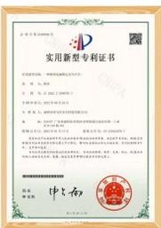


Patent and certificate gallery
Utility model patent certificate
Utility model patent certificate
Utility model patent certificate
Quality Management System Certification Certificate
Shenzhen Newmazz Safety Technology Co., Ltd.
Original certificate images. The small certificate text cannot be reliably transcribed at the supplied resolution.
NEWMAZZ 2026
008
Notes:
Source: supplied NEWMAZZ 2026 Product Selection Manual. Company honors, p. 02.
Original certificate images. The small certificate text cannot be reliably transcribed at the supplied resolution.

Slide 9
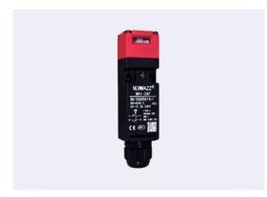
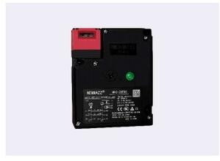
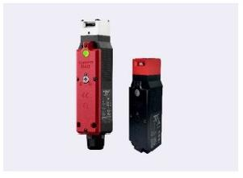
Product catalog
MA1
3 built-in contact sets
30 × 30 × 96 mm
M20 conduit entry
Manual page 05
MA2
Lock holding force 1,300 N
88 × 108 × 35.85 mm
M20 conduit entry
Manual page 09
MA3
Lock holding force 1,300 N
38.6 × 40.15 × 165 mm
M20 conduit entry
Manual page 15
NEWMAZZ 2026
009
Notes:
Source: supplied NEWMAZZ 2026 Product Selection Manual. Product catalog, pp. 03–04.

Slide 10
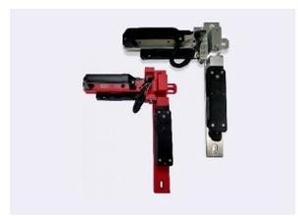
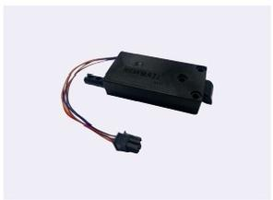
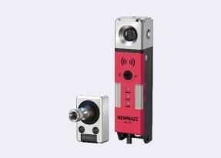
Product catalog
MAZ-K2 with MA2 / MA3
Compatible with MA1, MA2 and MA3
Manual page 22
MA6
Front or side mounting
16 × 37.5 × 73.5 mm
Manual release option
Manual page 26
MA50
Lock holding force 2,000 N
29.7 × 29.7 × 125.75 mm
RFID, standard or unique coding
Manual page 29
NEWMAZZ 2026
010
Notes:
Source: supplied NEWMAZZ 2026 Product Selection Manual. Product catalog, pp. 03–04.

Slide 11
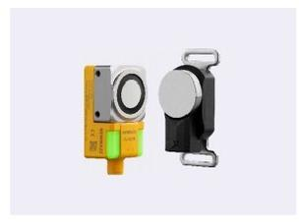
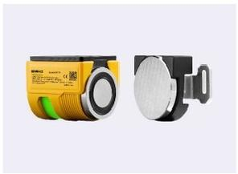
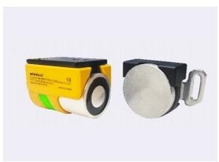
Product catalog
MA51L
Lock holding force 500 N
28.8 × 34 × 77.2 mm
16–20 cascaded units, standard or unique coding
Manual page 40
MA51P
Lock holding force 1,000 N
50.2 × 59.1 × 77 mm
16–20 cascaded units, standard or unique coding
Manual page 40
MA51
Lock holding force 500 N
39.8 × 49.3 × 72 mm
16–20 cascaded units, standard or unique coding
Manual page 40
NEWMAZZ 2026
011
Notes:
Source: supplied NEWMAZZ 2026 Product Selection Manual. Product catalog, pp. 03–04.

Slide 12
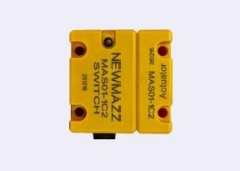
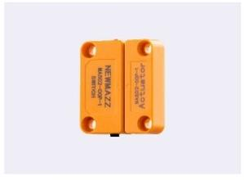
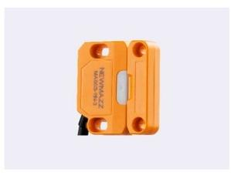
Product catalog
MAS01
24 V DC ±15%
12 × 23.3 × 36 mm
Compact size
Manual page 55
MAS02
24 V DC ±15%
48 × 25.5 × 12 mm
Compact size
Manual page 60
MAS03
Magnetic holding force 15 N
48 × 30 × 13 mm
Dual OSSD outputs
Manual page 65
NEWMAZZ 2026
012
Notes:
Source: supplied NEWMAZZ 2026 Product Selection Manual. Product catalog, pp. 03–04.

Slide 13
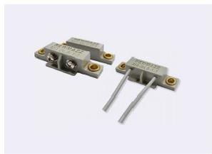
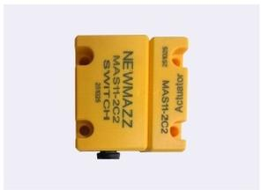
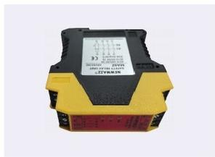
Product catalog
MA-GLS
Sensing distance 15 mm
Sensing head 50 × 14 × 14 mm
ABS housing
Manual page 71
MAS11
Multiple contact combinations
12 × 23.3 × 36 mm
Manual page 73
MA9Z
PNP or NPN options
22.5 × 99.7 × 112 mm
Manual page 78
NEWMAZZ 2026
013
Notes:
Source: supplied NEWMAZZ 2026 Product Selection Manual. Product catalog, pp. 03–04.

Slide 14
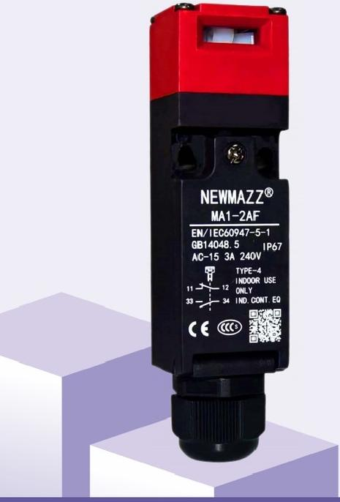
MA1 safety door switch
Multiple contact configurations are available.
Suitable for standard loads and small loads.
Simple installation and wiring reduce labor and make replacement easier.
A choice of metal heads is available.
MA1 series
NEWMAZZ 2026
014
Notes:
Source: supplied NEWMAZZ 2026 Product Selection Manual. MA1, pp. 05–08.

Slide 15
MA1 model code
Parameter | Specification
Code format | MA1-[conduit][contact][head]
Conduit entry | 1: Pg13.5 2: M20
Contact code A | 1NC/1NO, slow action
Contact code B | 2NC, slow action
Contact code C | 2NC/1NO, slow action
Contact code D | 3NC, slow action
Head code F | Plastic, four mounting directions, front orientation on delivery
Head code D | Metal, four mounting directions, front orientation on delivery
Switch heads and switch components cannot be ordered separately. Actuator keys are sold separately.
NEWMAZZ 2026
015
Notes:
Source: supplied NEWMAZZ 2026 Product Selection Manual. MA1 model structure, p. 05.
Switch heads and switch components cannot be ordered separately. Actuator keys are sold separately.

Slide 16
MA1 selection table 1
Head | Slow-action contacts | Conduit entry | Model
Plastic | 1NC/1NO | Pg13.5 | MA1-1AF
Plastic | 1NC/1NO | M20 | MA1-2AF
Plastic | 2NC | Pg13.5 | MA1-1BF
Plastic | 2NC | M20 | MA1-2BF
Plastic | 2NC/1NO | Pg13.5 | MA1-1CF
Plastic | 2NC/1NO | M20 | MA1-2CF
Plastic | 3NC | Pg13.5 | MA1-1DF
Plastic | 3NC | M20 | MA1-2DF
Metal | 1NC/1NO | Pg13.5 | MA1-1AD
Metal | 1NC/1NO | M20 | MA1-2AD
Metal | 2NC | Pg13.5 | MA1-1BD
Actuator keys are sold separately. Contact a NEWMAZZ sales representative for models not listed.
NEWMAZZ 2026
016
Notes:
Source: supplied NEWMAZZ 2026 Product Selection Manual. MA1 selection, p. 06.
Actuator keys are sold separately. Contact a NEWMAZZ sales representative for models not listed.

Slide 17
MA1 selection table 2
Head | Slow-action contacts | Conduit entry | Model
Metal | 2NC | M20 | MA1-2BD
Metal | 2NC/1NO | Pg13.5 | MA1-1CD
Metal | 2NC/1NO | M20 | MA1-2CD
Metal | 3NC | Pg13.5 | MA1-1DD
Metal | 3NC | M20 | MA1-2DD
Actuator keys are sold separately. Contact a NEWMAZZ sales representative for models not listed.
NEWMAZZ 2026
017
Notes:
Source: supplied NEWMAZZ 2026 Product Selection Manual. MA1 selection, p. 06.
Actuator keys are sold separately. Contact a NEWMAZZ sales representative for models not listed.

Slide 18
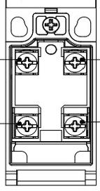
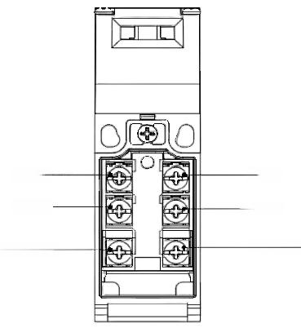
MA1 construction and terminals
Actuator key slot and switch head
Terminal layout
The switch head can mount in four directions.
The sealed switch housing provides IP67 protection.
Terminals: 11–12, 21–22 and 31(33)–32(34).
The manual states that the M12 conduit version uses the same terminal layout.
NEWMAZZ 2026
018
Notes:
Source: supplied NEWMAZZ 2026 Product Selection Manual. MA1 construction, p. 06.

Slide 19
MA1 specifications 1
Parameter | Specification
Certifications | CCC, CE
Standards | EN 60947-5-1, GB 14048.5, IEC 61508, EN ISO 14119
Protection / material | IP67 / flame-retardant PA66
Mechanical life | Over 1,000,000 operations
Electrical life | Over 150,000 operations
Utilization category | AC-15: 240 V, 3 A / DC-13: 24 V, 2 A
Contact resistance | ≤25 mΩ
Rated insulation voltage Ui | 300 V
Impulse withstand voltage | 2.5 kV between same-pole terminals, 4 kV between different poles, 6 kV between terminals and non-live metal
Short-circuit protection | Fast-acting fuse, 10 A, 250 V
Vibration resistance | 10–55 Hz, 1.5 mm double amplitude
NEWMAZZ 2026
019
Notes:
Source: supplied NEWMAZZ 2026 Product Selection Manual. MA1 electrical characteristics, p. 07.

Slide 20
MA1 specifications 2
Parameter | Specification
Shock resistance | Durability: 1,000 m/s² / malfunction: 300 m/s²
Conditional short-circuit current | 100 A (EN 60947-5-1)
Contact gap | At least 2 × 2 mm
Direct opening force | At least 60 N
Direct opening pretravel | At least 10 mm
Operating speed | 0.1–0.5 m/s
Maximum operating frequency | 20 operations/min
Pollution degree | 3 (EN 60947-5-1)
Operating temperature | −10 to +70 °C, no icing
Operating humidity | 85% RH
NEWMAZZ 2026
020
Notes:
Source: supplied NEWMAZZ 2026 Product Selection Manual. MA1 electrical characteristics, p. 07.

Slide 21
MA1 source-specific entries
Parameter | Specification
Protection against electric shock | The source reads “Class I (double insulation)”
Insulation resistance | The source reads “100 mQ or less (at 500 V DC or less)”
These two entries are inconsistent or unclear in the source. Confirm the intended class, resistance unit and inequality with the manufacturer.
NEWMAZZ 2026
021
Notes:
Source: supplied NEWMAZZ 2026 Product Selection Manual. MA1 electrical characteristics, p. 07.
These two entries are inconsistent or unclear in the source. Confirm the intended class, resistance unit and inequality with the manufacturer.

Slide 22
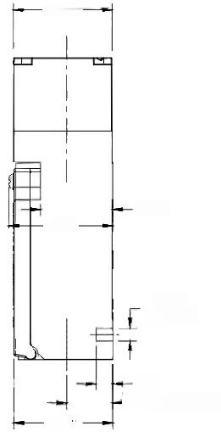
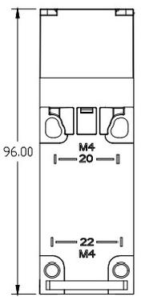
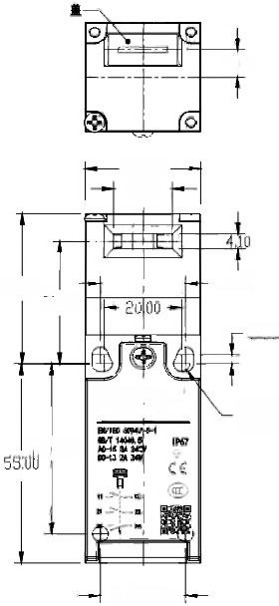
MA1 dimensions
Overall dimensions
Mounting layout
Dimension detail
Dimensions in mm.
Locating hole: Ø4.10. Mounting hole: Ø4.30.
Conduit entry center and mounting references follow the drawings.
NEWMAZZ 2026
022
Notes:
Source: supplied NEWMAZZ 2026 Product Selection Manual. MA1 dimensions, p. 08.

Slide 23



MA1 contact configuration A
Contact diagram, left
Contact diagram, right
Operating sequence
Models: MA1-1AF, MA1-2AF, MA1-1AD, MA1-2AD
Contacts: 1NC/1NO
The illustration shows the actuator key inserted and locked.
Sequence labels: actuator inserted, locked position, withdrawn position, travel.
Purple indicates contact ON (closed). White indicates contact OFF (open).
NEWMAZZ 2026
023
Notes:
Source: supplied NEWMAZZ 2026 Product Selection Manual. MA1 contact configurations, p. 08.

Slide 24



MA1 contact configuration B
Contact diagram, left
Contact diagram, right
Operating sequence
Models: MA1-1BF, MA1-2BF, MA1-1BD, MA1-2BD
Contacts: 2NC
The illustration shows the actuator key inserted and locked.
Sequence labels: actuator inserted, locked position, withdrawn position, travel.
Purple indicates contact ON (closed). White indicates contact OFF (open).
NEWMAZZ 2026
024
Notes:
Source: supplied NEWMAZZ 2026 Product Selection Manual. MA1 contact configurations, p. 08.

Slide 25



MA1 contact configuration C
Contact diagram, left
Contact diagram, right
Operating sequence
Models: MA1-1CF, MA1-2CF, MA1-1CD, MA1-2CD
Contacts: 2NC/1NO
The illustration shows the actuator key inserted and locked.
Sequence labels: actuator inserted, locked position, withdrawn position, travel.
Purple indicates contact ON (closed). White indicates contact OFF (open).
NEWMAZZ 2026
025
Notes:
Source: supplied NEWMAZZ 2026 Product Selection Manual. MA1 contact configurations, p. 08.

Slide 26



MA1 contact configuration D
Contact diagram, left
Contact diagram, right
Operating sequence
Models: MA1-1DF, MA1-2DF, MA1-1DD, MA1-2DD
Contacts: 3NC
The illustration shows the actuator key inserted and locked.
Sequence labels: actuator inserted, locked position, withdrawn position, travel.
Purple indicates contact ON (closed). White indicates contact OFF (open).
NEWMAZZ 2026
026
Notes:
Source: supplied NEWMAZZ 2026 Product Selection Manual. MA1 contact configurations, p. 08.

Slide 27
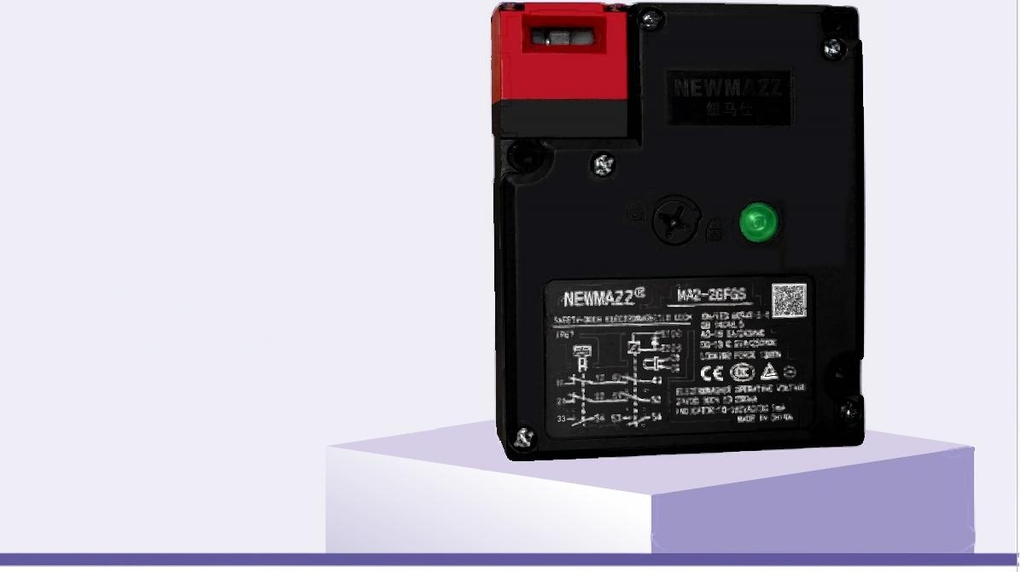
MA2 solenoid guard locking switch
Multiple built-in contact configurations.
Lock holding force: 1,300 N.
IP67 protection.
A choice of metal heads.
Suitable for standard loads and small loads.
Positive guard locking for machinery protection.
MA2 series
NEWMAZZ 2026
027
Notes:
Source: supplied NEWMAZZ 2026 Product Selection Manual. MA2, pp. 09–14.

Slide 28
MA2 applicable standards
EN 60947-5-1 / IEC 60947-5-1
GB/T 14048.5
EN ISO 14119
IEC 61508
EN ISO 13849-1
NEWMAZZ 2026
028
Notes:
Source: supplied NEWMAZZ 2026 Product Selection Manual. MA2, p. 09.

Slide 29
MA2 contact codes 1
Code | Door monitoring | Lock monitoring
A | 1NC/1NO | 1NC/1NO
B | 1NC/1NO | 2NC
C | 2NC | 1NC/1NO
D | 2NC | 2NC
E | 2NC/1NO | 1NC/1NO
F | 2NC/1NO | 2NC
G | 2NC/1NO | 2NC/1NO
H | 3NC | 1NC/1NO
I | 3NC | 2NC
All contacts use slow action.
NEWMAZZ 2026
029
Notes:
Source: supplied NEWMAZZ 2026 Product Selection Manual. MA2 model structure, p. 10.
All contacts use slow action.

Slide 30
MA2 contact codes 2
Code | Door monitoring | Lock monitoring
J | 3NC | 3NC
K | 3NC | 2NC/1NO
L | 2NC/1NO | 3NC
All contacts use slow action.
NEWMAZZ 2026
030
Notes:
Source: supplied NEWMAZZ 2026 Product Selection Manual. MA2 model structure, p. 10.
All contacts use slow action.

Slide 31
MA2 model code
Parameter | Specification
Format | MA2-[conduit][contact][head][locking][release position]-[LED]
Conduit entry | 1: Pg13.5 / 2: M20
Head F / D | F: plastic / D: metal. Four mounting directions, front orientation on delivery.
Locking A | Mechanical locking, 24 V DC solenoid release
Locking B | Mechanical locking, 110 V AC solenoid release
Locking G | 24 V DC solenoid locking, mechanical release
Locking H | 110 V AC solenoid locking, mechanical release
Release key position | F: top / S: front
Indicator suffix | Blank: standard 24 V DC, green LED / B: 24 V DC, orange LED
NEWMAZZ 2026
031
Notes:
Source: supplied NEWMAZZ 2026 Product Selection Manual. MA2 model structure, p. 10.

Slide 32
MA2 selection A 1
Code | Door + lock contacts | Pg13.5 model | M20 model
A | 1NC/1NO + 1NC/1NO | MA2-1AFAS | MA2-2AFAS
B | 1NC/1NO + 2NC | MA2-1BFAS | MA2-2BFAS
C | 2NC + 1NC/1NO | MA2-1CFAS | MA2-2CFAS
D | 2NC + 2NC | MA2-1DFAS | MA2-2DFAS
E | 2NC/1NO + 1NC/1NO | MA2-1EFAS | MA2-2EFAS
F | 2NC/1NO + 2NC | MA2-1FFAS | MA2-2FFAS
G | 2NC/1NO + 2NC/1NO | MA2-1GFAS | MA2-2GFAS
H | 3NC + 1NC/1NO | MA2-1HFAS | MA2-2HFAS
I | 3NC + 2NC | MA2-1IFAS | MA2-2IFAS
Plastic head, 24 V DC solenoid, green LED. Mechanical locking / solenoid release. Actuator key sold separately.
NEWMAZZ 2026
032
Notes:
Source: supplied NEWMAZZ 2026 Product Selection Manual. MA2 selection, p. 11.
Plastic head, 24 V DC solenoid, green LED. Mechanical locking / solenoid release. Actuator key sold separately.

Slide 33
MA2 selection A 2
Code | Door + lock contacts | Pg13.5 model | M20 model
J | 3NC + 3NC | MA2-1JFAS | MA2-2JFAS
K | 3NC + 2NC/1NO | MA2-1KFAS | MA2-2KFAS
L | 2NC/1NO + 3NC | MA2-1LFAS | MA2-2LFAS
Plastic head, 24 V DC solenoid, green LED. Mechanical locking / solenoid release. Actuator key sold separately.
NEWMAZZ 2026
033
Notes:
Source: supplied NEWMAZZ 2026 Product Selection Manual. MA2 selection, p. 11.
Plastic head, 24 V DC solenoid, green LED. Mechanical locking / solenoid release. Actuator key sold separately.

Slide 34
MA2 selection G 1
Code | Door + lock contacts | Pg13.5 model | M20 model
A | 1NC/1NO + 1NC/1NO | MA2-1AFGS | MA2-2AFGS
B | 1NC/1NO + 2NC | MA2-1BFGS | MA2-2BFGS
C | 2NC + 1NC/1NO | MA2-1CFGS | MA2-2CFGS
D | 2NC + 2NC | MA2-1DFGS | MA2-2DFGS
E | 2NC/1NO + 1NC/1NO | MA2-1EFGS | MA2-2EFGS
F | 2NC/1NO + 2NC | MA2-1FFGS | MA2-2FFGS
G | 2NC/1NO + 2NC/1NO | MA2-1GFGS | MA2-2GFGS
H | 3NC + 1NC/1NO | MA2-1HFGS | MA2-2HFGS
I | 3NC + 2NC | MA2-1IFGS | MA2-2IFGS
Plastic head, 24 V DC solenoid, green LED. Solenoid locking / mechanical release. Actuator key sold separately.
NEWMAZZ 2026
034
Notes:
Source: supplied NEWMAZZ 2026 Product Selection Manual. MA2 selection, p. 11.
Plastic head, 24 V DC solenoid, green LED. Solenoid locking / mechanical release. Actuator key sold separately.

Slide 35
MA2 selection G 2
Code | Door + lock contacts | Pg13.5 model | M20 model
J | 3NC + 3NC | MA2-1JFGS | MA2-2JFGS
K | 3NC + 2NC/1NO | MA2-1KFGS | MA2-2KFGS
L | 2NC/1NO + 3NC | MA2-1LFGS | MA2-2LFGS
Plastic head, 24 V DC solenoid, green LED. Solenoid locking / mechanical release. Actuator key sold separately.
NEWMAZZ 2026
035
Notes:
Source: supplied NEWMAZZ 2026 Product Selection Manual. MA2 selection, p. 11.
Plastic head, 24 V DC solenoid, green LED. Solenoid locking / mechanical release. Actuator key sold separately.

Slide 36
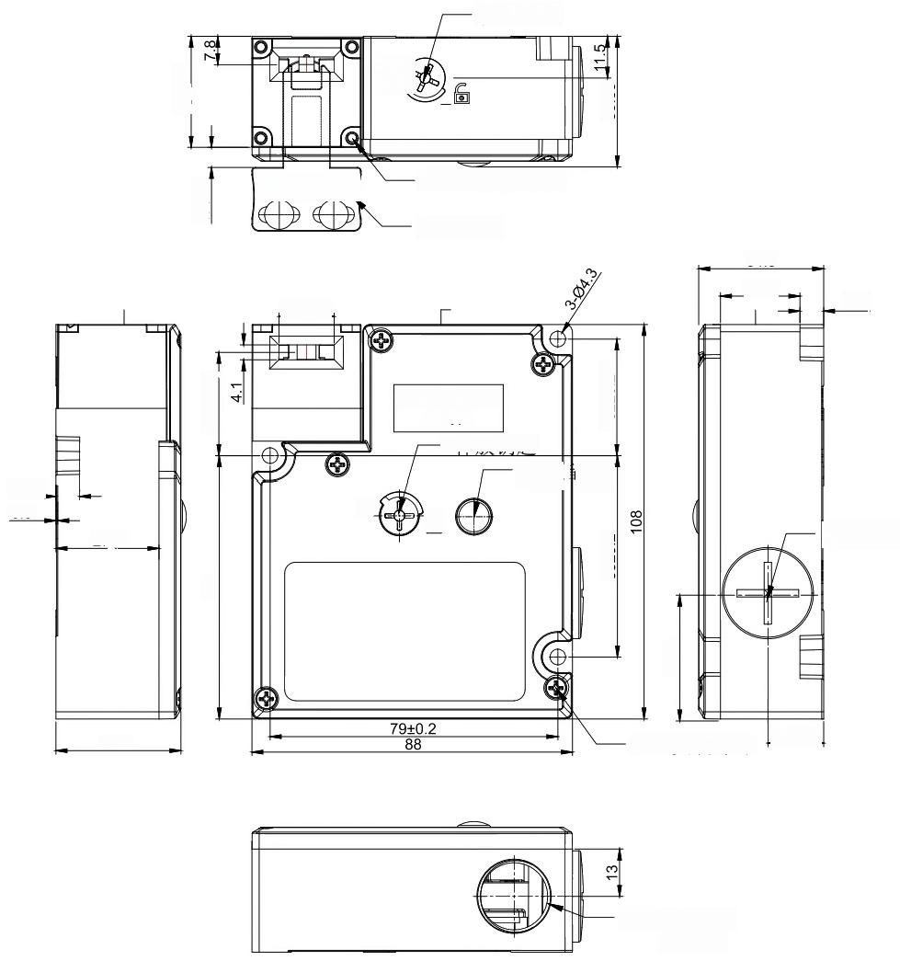
MA2 dimensions and mounting
All dimensions in mm.
Drawing labels: travel, release key, head mounting screws (4), actuator key, LED indicator, cover retaining screws and conduit entry.
The release key and actuator key positions follow the supplied dimension drawing.
MA2 overall and mounting dimensions
NEWMAZZ 2026
036
Notes:
Source: supplied NEWMAZZ 2026 Product Selection Manual. MA2 dimensions, p. 12.

Slide 37
MA2 specifications 1
Parameter | Specification
Certifications | CCC, CE, TÜV Rheinland, SIL3
Standards | EN 60947-5-1, GB 14048.5, IEC 61508, EN ISO 14119
Protection / material | IP67 / flame-retardant PA66
Mechanical life | Over 1,000,000 operations
Electrical life | Over 150,000 operations at 240 V AC, 3 A resistive load
Utilization category | AC-15: 240 V, 3 A / DC-13: 24 V, 2 A
Contact resistance | ≤25 mΩ
Rated insulation voltage Ui | 300 V
Impulse withstand voltage | 2.5 kV between same-pole terminals, 4 kV between different poles, 6 kV between terminals and non-live metal
Short-circuit protection | Fast-acting fuse, 10 A, 250 V
Vibration resistance | 10–55 Hz, 1.5 mm double amplitude
NEWMAZZ 2026
037
Notes:
Source: supplied NEWMAZZ 2026 Product Selection Manual. MA2 electrical characteristics, p. 13.

Slide 38
MA2 specifications 2
Parameter | Specification
Shock resistance | Durability: 1,000 m/s² / malfunction: 300 m/s²
Conditional short-circuit current | 100 A (EN 60947-5-1)
Contact gap | At least 2 × 2 mm
Direct opening force | At least 60 N
Direct opening pretravel | At least 10 mm
Operating speed | 0.1–0.5 m/s
Maximum operating frequency | 30 operations/min
Pollution degree | 3 (EN 60947-5-1)
Operating temperature | −10 to +55 °C, no icing
Operating humidity | ≤95% RH
Rated thermal current Ith | 10 A
NEWMAZZ 2026
038
Notes:
Source: supplied NEWMAZZ 2026 Product Selection Manual. MA2 electrical characteristics, p. 13.

Slide 39
MA2 specifications 3
Parameter | Specification
Insulation resistance | At least 100 MΩ (source typography is unclear)
Electric shock protection | Class II, double insulation
Lock holding force | 1,300 N
NEWMAZZ 2026
039
Notes:
Source: supplied NEWMAZZ 2026 Product Selection Manual. MA2 electrical characteristics, p. 13.

Slide 40
MA2 solenoid and LED
Parameter | Specification
Solenoid rated voltage | 24 V DC
Power | 4.8 W
Solenoid rated current | Approximately 200 mA
Solenoid insulation | Class B, 130 °C
LED rated voltage | 24 V DC
LED rated current | Approximately 1 mA
LED color | Green
NEWMAZZ 2026
040
Notes:
Source: supplied NEWMAZZ 2026 Product Selection Manual. MA2, p. 13.

Slide 41


MA2 contact configuration A
Original contact / operating-sequence artwork
Original contact / operating-sequence artwork
Contact code A: 1NC/1NO + 1NC/1NO.
Door monitoring + lock monitoring.
The actuator key is inserted and locked.
Diagram labels: actuator inserted, locked position, withdrawn position, travel, door monitoring and lock monitoring.
ON = closed contact. OFF = open contact.
NEWMAZZ 2026
041
Notes:
Source: supplied NEWMAZZ 2026 Product Selection Manual. MA2 contact configurations, p. 14.

Slide 42


MA2 contact configuration B
Original contact / operating-sequence artwork
Original contact / operating-sequence artwork
Original contact / operating-sequence artwork
Contact code B: 1NC/1NO + 2NC.
Door monitoring + lock monitoring.
The actuator key is inserted and locked.
Diagram labels: actuator inserted, locked position, withdrawn position, travel, door monitoring and lock monitoring.
ON = closed contact. OFF = open contact.
NEWMAZZ 2026
042
Notes:
Source: supplied NEWMAZZ 2026 Product Selection Manual. MA2 contact configurations, p. 14.

Slide 43


MA2 contact configuration C
Original contact / operating-sequence artwork
Original contact / operating-sequence artwork
Contact code C: 2NC + 1NC/1NO.
Door monitoring + lock monitoring.
The actuator key is inserted and locked.
Diagram labels: actuator inserted, locked position, withdrawn position, travel, door monitoring and lock monitoring.
ON = closed contact. OFF = open contact.
NEWMAZZ 2026
043
Notes:
Source: supplied NEWMAZZ 2026 Product Selection Manual. MA2 contact configurations, p. 14.

Slide 44


MA2 contact configuration D
Original contact / operating-sequence artwork
Original contact / operating-sequence artwork
Contact code D: 2NC + 2NC.
Door monitoring + lock monitoring.
The actuator key is inserted and locked.
Diagram labels: actuator inserted, locked position, withdrawn position, travel, door monitoring and lock monitoring.
ON = closed contact. OFF = open contact.
NEWMAZZ 2026
044
Notes:
Source: supplied NEWMAZZ 2026 Product Selection Manual. MA2 contact configurations, p. 14.

Slide 45


MA2 contact configuration E
Original contact / operating-sequence artwork
Original contact / operating-sequence artwork
Contact code E: 2NC/1NO + 1NC/1NO.
Door monitoring + lock monitoring.
The actuator key is inserted and locked.
Diagram labels: actuator inserted, locked position, withdrawn position, travel, door monitoring and lock monitoring.
ON = closed contact. OFF = open contact.
NEWMAZZ 2026
045
Notes:
Source: supplied NEWMAZZ 2026 Product Selection Manual. MA2 contact configurations, p. 14.

Slide 46


MA2 contact configuration F
Original contact / operating-sequence artwork
Original contact / operating-sequence artwork
Contact code F: 2NC/1NO + 2NC.
Door monitoring + lock monitoring.
The actuator key is inserted and locked.
Diagram labels: actuator inserted, locked position, withdrawn position, travel, door monitoring and lock monitoring.
ON = closed contact. OFF = open contact.
NEWMAZZ 2026
046
Notes:
Source: supplied NEWMAZZ 2026 Product Selection Manual. MA2 contact configurations, p. 14.

Slide 47


MA2 contact configuration G
Original contact / operating-sequence artwork
Original contact / operating-sequence artwork
Contact code G: 2NC/1NO + 2NC/1NO.
Door monitoring + lock monitoring.
The actuator key is inserted and locked.
Diagram labels: actuator inserted, locked position, withdrawn position, travel, door monitoring and lock monitoring.
ON = closed contact. OFF = open contact.
NEWMAZZ 2026
047
Notes:
Source: supplied NEWMAZZ 2026 Product Selection Manual. MA2 contact configurations, p. 14.

Slide 48


MA2 contact configuration H
Original contact / operating-sequence artwork
Original contact / operating-sequence artwork
Contact code H: 3NC + 1NC/1NO.
Door monitoring + lock monitoring.
The actuator key is inserted and locked.
Diagram labels: actuator inserted, locked position, withdrawn position, travel, door monitoring and lock monitoring.
ON = closed contact. OFF = open contact.
NEWMAZZ 2026
048
Notes:
Source: supplied NEWMAZZ 2026 Product Selection Manual. MA2 contact configurations, p. 14.

Slide 49


MA2 contact configuration I
Original contact / operating-sequence artwork
Original contact / operating-sequence artwork
Contact code I: 3NC + 2NC.
Door monitoring + lock monitoring.
The actuator key is inserted and locked.
Diagram labels: actuator inserted, locked position, withdrawn position, travel, door monitoring and lock monitoring.
ON = closed contact. OFF = open contact.
NEWMAZZ 2026
049
Notes:
Source: supplied NEWMAZZ 2026 Product Selection Manual. MA2 contact configurations, p. 14.

Slide 50


MA2 contact configuration J
Original contact / operating-sequence artwork
Original contact / operating-sequence artwork
Contact code J: 3NC + 3NC.
Door monitoring + lock monitoring.
The actuator key is inserted and locked.
Diagram labels: actuator inserted, locked position, withdrawn position, travel, door monitoring and lock monitoring.
ON = closed contact. OFF = open contact.
NEWMAZZ 2026
050
Notes:
Source: supplied NEWMAZZ 2026 Product Selection Manual. MA2 contact configurations, p. 14.

Slide 51


MA2 contact configuration K
Original contact / operating-sequence artwork
Original contact / operating-sequence artwork
Original contact / operating-sequence artwork
Contact code K: 3NC + 2NC/1NO.
Door monitoring + lock monitoring.
The actuator key is inserted and locked.
Diagram labels: actuator inserted, locked position, withdrawn position, travel, door monitoring and lock monitoring.
ON = closed contact. OFF = open contact.
NEWMAZZ 2026
051
Notes:
Source: supplied NEWMAZZ 2026 Product Selection Manual. MA2 contact configurations, p. 14.

Slide 52


MA2 contact configuration L
Original contact / operating-sequence artwork
Original contact / operating-sequence artwork
Contact code L: 2NC/1NO + 3NC.
Door monitoring + lock monitoring.
The actuator key is inserted and locked.
Diagram labels: actuator inserted, locked position, withdrawn position, travel, door monitoring and lock monitoring.
ON = closed contact. OFF = open contact.
NEWMAZZ 2026
052
Notes:
Source: supplied NEWMAZZ 2026 Product Selection Manual. MA2 contact configurations, p. 14.

Slide 53
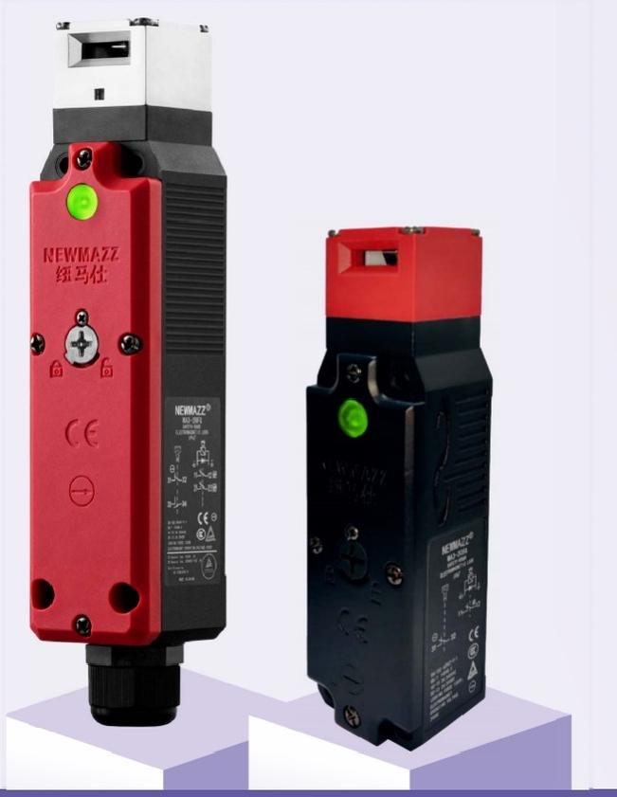
MA3 solenoid guard locking switch
Multiple built-in contact configurations.
Lock holding force: 1,300 N.
IP67 protection.
A choice of metal heads.
Suitable for standard loads and small loads.
Standards: EN/IEC 60947-5-1, GB/T 14048.5, IEC 61508, EN ISO 14119, EN ISO 13849-1, UL 508, CSA C22.2 No. 14.
MA3 series
NEWMAZZ 2026
053
Notes:
Source: supplied NEWMAZZ 2026 Product Selection Manual. MA3, pp. 15–21.

Slide 54
MA3 contact codes 1
Code | Lock monitoring | Door monitoring
A | 1NC | 1NO
B | 2NC | 1NC/1NO
C | 1NC | 1NC
D | 1NC | 2NC
E | 2NC | 2NO
F | 1NC | 1NC/1NO
G | 2NC | 2NC
H | 1NC/1NO | 1NC/1NO
I | 3NC | 1NO
J | 3NC | 1NC
K | 2NC/1NO | 1NO
All contacts use slow action. The source lists contacts in lock monitoring + door monitoring order.
NEWMAZZ 2026
054
Notes:
Source: supplied NEWMAZZ 2026 Product Selection Manual. MA3 model structure, pp. 15–16.
All contacts use slow action. The source lists contacts in lock monitoring + door monitoring order.

Slide 55
MA3 contact codes 2
Code | Lock monitoring | Door monitoring
L | 1NC | 3NC
M | 1NC/1NO | 2NC
N | 1NC/1NO | 2NO
All contacts use slow action. The source lists contacts in lock monitoring + door monitoring order.
NEWMAZZ 2026
055
Notes:
Source: supplied NEWMAZZ 2026 Product Selection Manual. MA3 model structure, pp. 15–16.
All contacts use slow action. The source lists contacts in lock monitoring + door monitoring order.

Slide 56
MA3 model code
Parameter | Specification
Format | MA3-[conduit][contact][head][locking]-[options]
Conduit entry | 1: Pg13.5 / 2: M20 / 3: M16
Head F / D | F: plastic / D: metal. Four mounting directions, front orientation on delivery.
Locking A / B | A: mechanical locking, 24 V DC release / B: mechanical locking, 110 V AC release
Locking G / H | G: 24 V DC solenoid locking, mechanical release / H: 110 V AC solenoid locking, mechanical release
Release position | Blank: front / F: rear
Indicator | Blank: standard 24 V DC green LED / B: 24 V DC orange LED
Special release | H: special release key, supplied with the product
Switch heads and switch components cannot be ordered separately. Actuator keys are sold separately.
NEWMAZZ 2026
056
Notes:
Source: supplied NEWMAZZ 2026 Product Selection Manual. MA3 model structure, pp. 15–16.
Switch heads and switch components cannot be ordered separately. Actuator keys are sold separately.

Slide 57
MA3 plastic head selection A 1
Lock + door contacts | Conduit entry | Model
1NC + 1NO | Pg13.5 | MA3-1AFA
1NC + 1NO | M20 | MA3-2AFA
1NC + 1NO | M16 | MA3-3AFA
2NC + 1NC/1NO | Pg13.5 | MA3-1BFA
2NC + 1NC/1NO | M20 | MA3-2BFA
1NC + 1NC | Pg13.5 | MA3-1CFA
1NC + 1NC | M20 | MA3-2CFA
1NC + 1NC | M16 | MA3-3CFA
1NC + 2NC | Pg13.5 | MA3-1DFA
1NC + 2NC | M20 | MA3-2DFA
2NC + 2NO | Pg13.5 | MA3-1EFA
24 V DC solenoid, green LED. Mechanical locking / solenoid release. Actuator key sold separately.
NEWMAZZ 2026
057
Notes:
Source: supplied NEWMAZZ 2026 Product Selection Manual. MA3 selection, pp. 17–18.
24 V DC solenoid, green LED. Mechanical locking / solenoid release. Actuator key sold separately.

Slide 58
MA3 plastic head selection A 2
Lock + door contacts | Conduit entry | Model
2NC + 2NO | M20 | MA3-2EFA
1NC + 1NC/1NO | Pg13.5 | MA3-1FFA
1NC + 1NC/1NO | M20 | MA3-2FFA
2NC + 2NC | Pg13.5 | MA3-1GFA
2NC + 2NC | M20 | MA3-2GFA
1NC/1NO + 1NC/1NO | Pg13.5 | MA3-1HFA
1NC/1NO + 1NC/1NO | M20 | MA3-2HFA
3NC + 1NO | Pg13.5 | MA3-1IFA
3NC + 1NO | M20 | MA3-2IFA
3NC + 1NC | Pg13.5 | MA3-1JFA
3NC + 1NC | M20 | MA3-2JFA
24 V DC solenoid, green LED. Mechanical locking / solenoid release. Actuator key sold separately.
NEWMAZZ 2026
058
Notes:
Source: supplied NEWMAZZ 2026 Product Selection Manual. MA3 selection, pp. 17–18.
24 V DC solenoid, green LED. Mechanical locking / solenoid release. Actuator key sold separately.

Slide 59
MA3 plastic head selection G 1
Lock + door contacts | Conduit entry | Model
1NC + 1NO | Pg13.5 | MA3-1AFG
1NC + 1NO | M20 | MA3-2AFG
1NC + 1NO | M16 | MA3-3AFG
2NC + 1NC/1NO | Pg13.5 | MA3-1BFG
2NC + 1NC/1NO | M20 | MA3-2BFG
1NC + 1NC | Pg13.5 | MA3-1CFG
1NC + 1NC | M20 | MA3-2CFG
1NC + 1NC | M16 | MA3-3CFG
1NC + 2NC | Pg13.5 | MA3-1DFG
1NC + 2NC | M20 | MA3-2DFG
2NC + 2NO | Pg13.5 | MA3-1EFG
24 V DC solenoid, green LED. Solenoid locking / mechanical release. Actuator key sold separately.
NEWMAZZ 2026
059
Notes:
Source: supplied NEWMAZZ 2026 Product Selection Manual. MA3 selection, pp. 17–18.
24 V DC solenoid, green LED. Solenoid locking / mechanical release. Actuator key sold separately.

Slide 60
MA3 plastic head selection G 2
Lock + door contacts | Conduit entry | Model
2NC + 2NO | M20 | MA3-2EFG
1NC + 1NC/1NO | Pg13.5 | MA3-1FFG
1NC + 1NC/1NO | M20 | MA3-2FFG
2NC + 2NC | Pg13.5 | MA3-1GFG
2NC + 2NC | M20 | MA3-2GFG
1NC/1NO + 1NC/1NO | Pg13.5 | MA3-1HFG
1NC/1NO + 1NC/1NO | M20 | MA3-2HFG
3NC + 1NO | Pg13.5 | MA3-1IFG
3NC + 1NO | M20 | MA3-2IFG
3NC + 1NC | Pg13.5 | MA3-1JFG
3NC + 1NC | M20 | MA3-2JFG
24 V DC solenoid, green LED. Solenoid locking / mechanical release. Actuator key sold separately.
NEWMAZZ 2026
060
Notes:
Source: supplied NEWMAZZ 2026 Product Selection Manual. MA3 selection, pp. 17–18.
24 V DC solenoid, green LED. Solenoid locking / mechanical release. Actuator key sold separately.

Slide 61
MA3 metal head selection 1
Lock code | Lock + door contacts | M20 model
A | 2NC + 1NC/1NO | MA3-2BDA
A | 2NC + 2NO | MA3-2EDA
A | 2NC + 2NC | MA3-2GDA
A | 1NC/1NO + 1NC/1NO | MA3-2HDA
A | 3NC + 1NO | MA3-2IDA
A | 3NC + 1NC | MA3-2JDA
G | 2NC + 1NC/1NO | MA3-2BDG
G | 2NC + 2NO | MA3-2EDG
G | 2NC + 2NC | MA3-2GDG
24 V DC, green LED. A: mechanical locking / solenoid release. G: solenoid locking / mechanical release.
NEWMAZZ 2026
061
Notes:
Source: supplied NEWMAZZ 2026 Product Selection Manual. MA3 selection, p. 18.
24 V DC, green LED. A: mechanical locking / solenoid release. G: solenoid locking / mechanical release.

Slide 62
MA3 metal head selection 2
Lock code | Lock + door contacts | M20 model
G | 1NC/1NO + 1NC/1NO | MA3-2HDG
G | 3NC + 1NO | MA3-2IDG
G | 3NC + 1NC | MA3-2JDG
24 V DC, green LED. A: mechanical locking / solenoid release. G: solenoid locking / mechanical release.
NEWMAZZ 2026
062
Notes:
Source: supplied NEWMAZZ 2026 Product Selection Manual. MA3 selection, p. 18.
24 V DC, green LED. A: mechanical locking / solenoid release. G: solenoid locking / mechanical release.

Slide 63
MA3 specifications 1
Parameter | Specification
Certifications | CCC, CE, TÜV Rheinland, cTÜVus, SIL3
Standards | EN 60947-5-1, GB 14048.5, IEC 61508, EN ISO 14119, UL 508, CSA C22.2 No. 14
Protection / material | IP67 / flame-retardant PA66
Mechanical life | Over 1,000,000 operations
Electrical life | Over 150,000 operations at 240 V AC, 3 A resistive load
Utilization category | AC-15: 240 V, 3 A / DC-13: 24 V, 2 A
Contact resistance | ≤25 mΩ
Rated insulation voltage Ui | 300 V
Impulse withstand voltage | 2.5 kV between same-pole terminals, 4 kV between different poles, 6 kV between terminals and non-live metal
Short-circuit protection | Fast-acting fuse, 10 A, 250 V
Vibration resistance | 10–55 Hz, 1.5 mm double amplitude
NEWMAZZ 2026
063
Notes:
Source: supplied NEWMAZZ 2026 Product Selection Manual. MA3 electrical characteristics, p. 19.

Slide 64
MA3 specifications 2
Parameter | Specification
Shock resistance | Durability: 1,000 m/s² / malfunction: 300 m/s²
Conditional short-circuit current | 100 A (EN 60947-5-1)
Contact gap | At least 2 × 2 mm
Direct opening force | At least 60 N
Direct opening pretravel | At least 10 mm
Operating speed | 0.1–0.5 m/s
Maximum operating frequency | 30 operations/min
Pollution degree | 3 (EN 60947-5-1)
Operating temperature | −10 to +55 °C, no icing
Operating humidity | ≤95% RH
Rated thermal current Ith | 10 A
NEWMAZZ 2026
064
Notes:
Source: supplied NEWMAZZ 2026 Product Selection Manual. MA3 electrical characteristics, p. 19.

Slide 65
MA3 specifications 3
Parameter | Specification
Insulation resistance | At least 100 MΩ (source typography is unclear)
Electric shock protection | Source reads “Class I (double insulation)”. Confirm the intended class.
Lock holding force | 1,300 N
NEWMAZZ 2026
065
Notes:
Source: supplied NEWMAZZ 2026 Product Selection Manual. MA3 electrical characteristics, p. 19.

Slide 66
MA3 solenoid and LED
Parameter | Specification
Solenoid rated voltage | 24 V DC
Power | Max. 3.8 W, temporarily max. 15.1 W after lock control
Solenoid rated current | Approximately 200 mA
Solenoid insulation | Class B, 130 °C
LED | 24 V DC, approximately 1 mA, green
NEWMAZZ 2026
066
Notes:
Source: supplied NEWMAZZ 2026 Product Selection Manual. MA3, p. 19.

Slide 67
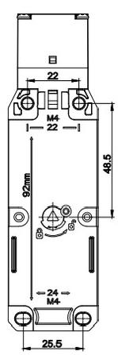
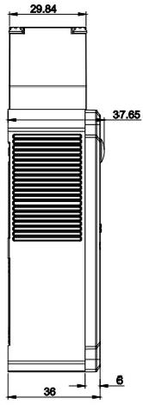
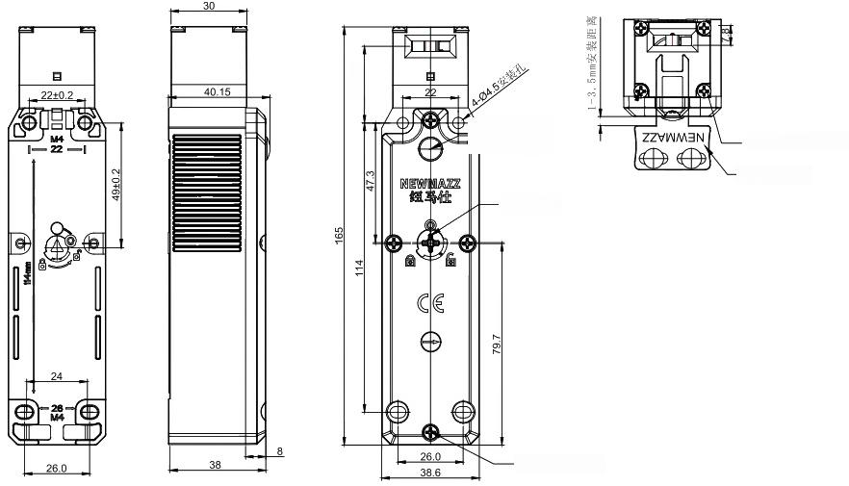
MA3 dimensions 1
Overall dimensions
MA3 front view
Side view
All dimensions in mm. Drawing labels: head mounting screws (4), actuator key, LED indicator, release key and cover mounting screws.
NEWMAZZ 2026
067
Notes:
Source: supplied NEWMAZZ 2026 Product Selection Manual. MA3 dimensions, p. 20.

Slide 68
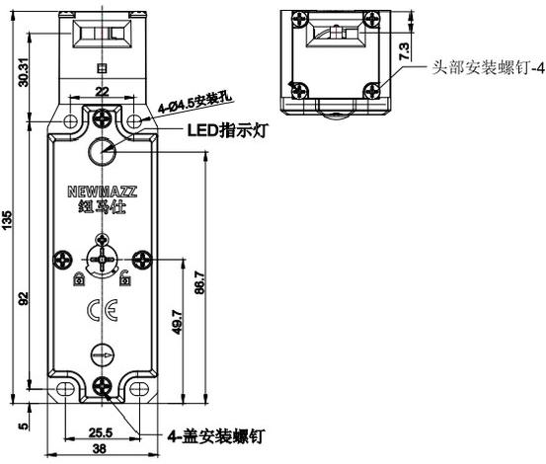
MA3 dimensions 2
All dimensions in mm. Drawing labels: head mounting screws (4), actuator key, LED indicator, release key and cover mounting screws.
MA3-3 dimensions
NEWMAZZ 2026
068
Notes:
Source: supplied NEWMAZZ 2026 Product Selection Manual. MA3 dimensions, p. 20.

Slide 69


MA3 contact configuration A
Original contact / operating-sequence artwork
Original contact / operating-sequence artwork
Contact code A: 1NC + 1NO.
Lock monitoring + door monitoring.
The actuator key is inserted and locked.
Diagram labels: actuator inserted, locked position, withdrawn position, travel, door monitoring and lock monitoring.
ON = closed contact. OFF = open contact.
NEWMAZZ 2026
069
Notes:
Source: supplied NEWMAZZ 2026 Product Selection Manual. MA3 contact configurations, p. 21.

Slide 70


MA3 contact configuration B
Original contact / operating-sequence artwork
Original contact / operating-sequence artwork
Contact code B: 2NC + 1NC/1NO.
Lock monitoring + door monitoring.
The actuator key is inserted and locked.
Diagram labels: actuator inserted, locked position, withdrawn position, travel, door monitoring and lock monitoring.
ON = closed contact. OFF = open contact.
NEWMAZZ 2026
070
Notes:
Source: supplied NEWMAZZ 2026 Product Selection Manual. MA3 contact configurations, p. 21.

Slide 71

MA3 contact configuration C
Original contact / operating-sequence artwork
Original contact / operating-sequence artwork
Contact code C: 1NC + 1NC.
Lock monitoring + door monitoring.
The actuator key is inserted and locked.
Diagram labels: actuator inserted, locked position, withdrawn position, travel, door monitoring and lock monitoring.
ON = closed contact. OFF = open contact.
NEWMAZZ 2026
071
Notes:
Source: supplied NEWMAZZ 2026 Product Selection Manual. MA3 contact configurations, p. 21.

Slide 72

MA3 contact configuration D
Original contact / operating-sequence artwork
Original contact / operating-sequence artwork
Original contact / operating-sequence artwork
Contact code D: 1NC + 2NC.
Lock monitoring + door monitoring.
The actuator key is inserted and locked.
Diagram labels: actuator inserted, locked position, withdrawn position, travel, door monitoring and lock monitoring.
ON = closed contact. OFF = open contact.
NEWMAZZ 2026
072
Notes:
Source: supplied NEWMAZZ 2026 Product Selection Manual. MA3 contact configurations, p. 21.

Slide 73

MA3 contact configuration E
Original contact / operating-sequence artwork
Original contact / operating-sequence artwork
Contact code E: 2NC + 2NO.
Lock monitoring + door monitoring.
The actuator key is inserted and locked.
Diagram labels: actuator inserted, locked position, withdrawn position, travel, door monitoring and lock monitoring.
ON = closed contact. OFF = open contact.
NEWMAZZ 2026
073
Notes:
Source: supplied NEWMAZZ 2026 Product Selection Manual. MA3 contact configurations, p. 21.

Slide 74

MA3 contact configuration F
Contact code F: 1NC + 1NC/1NO.
Lock monitoring + door monitoring.
The actuator key is inserted and locked.
Diagram labels: actuator inserted, locked position, withdrawn position, travel, door monitoring and lock monitoring.
ON = closed contact. OFF = open contact.
Original contact / operating-sequence artwork
NEWMAZZ 2026
074
Notes:
Source: supplied NEWMAZZ 2026 Product Selection Manual. MA3 contact configurations, p. 21.

Slide 75

MA3 contact configuration G
Contact code G: 2NC + 2NC.
Lock monitoring + door monitoring.
The actuator key is inserted and locked.
Diagram labels: actuator inserted, locked position, withdrawn position, travel, door monitoring and lock monitoring.
ON = closed contact. OFF = open contact.
Original contact / operating-sequence artwork
NEWMAZZ 2026
075
Notes:
Source: supplied NEWMAZZ 2026 Product Selection Manual. MA3 contact configurations, p. 21.

Slide 76

MA3 contact configuration H
Contact code H: 1NC/1NO + 1NC/1NO.
Lock monitoring + door monitoring.
The actuator key is inserted and locked.
Diagram labels: actuator inserted, locked position, withdrawn position, travel, door monitoring and lock monitoring.
ON = closed contact. OFF = open contact.
Original contact / operating-sequence artwork
NEWMAZZ 2026
076
Notes:
Source: supplied NEWMAZZ 2026 Product Selection Manual. MA3 contact configurations, p. 21.

Slide 77

MA3 contact configuration I
Original contact / operating-sequence artwork
Original contact / operating-sequence artwork
Contact code I: 3NC + 1NO.
Lock monitoring + door monitoring.
The actuator key is inserted and locked.
Diagram labels: actuator inserted, locked position, withdrawn position, travel, door monitoring and lock monitoring.
ON = closed contact. OFF = open contact.
NEWMAZZ 2026
077
Notes:
Source: supplied NEWMAZZ 2026 Product Selection Manual. MA3 contact configurations, p. 21.

Slide 78


MA3 contact configuration J
Original contact / operating-sequence artwork
Original contact / operating-sequence artwork
Contact code J: 3NC + 1NC.
Lock monitoring + door monitoring.
The actuator key is inserted and locked.
Diagram labels: actuator inserted, locked position, withdrawn position, travel, door monitoring and lock monitoring.
ON = closed contact. OFF = open contact.
NEWMAZZ 2026
078
Notes:
Source: supplied NEWMAZZ 2026 Product Selection Manual. MA3 contact configurations, p. 21.

Slide 79


MA3 contact configuration K
Original contact / operating-sequence artwork
Original contact / operating-sequence artwork
Contact code K: 2NC/1NO + 1NO.
Lock monitoring + door monitoring.
The actuator key is inserted and locked.
Diagram labels: actuator inserted, locked position, withdrawn position, travel, door monitoring and lock monitoring.
ON = closed contact. OFF = open contact.
NEWMAZZ 2026
079
Notes:
Source: supplied NEWMAZZ 2026 Product Selection Manual. MA3 contact configurations, p. 21.

Slide 80



MA3 contact configuration L
Original contact / operating-sequence artwork
Original contact / operating-sequence artwork
Original contact / operating-sequence artwork
Contact code L: 1NC + 3NC.
Lock monitoring + door monitoring.
The actuator key is inserted and locked.
Diagram labels: actuator inserted, locked position, withdrawn position, travel, door monitoring and lock monitoring.
ON = closed contact. OFF = open contact.
NEWMAZZ 2026
080
Notes:
Source: supplied NEWMAZZ 2026 Product Selection Manual. MA3 contact configurations, p. 21.

Slide 81



MA3 contact configuration M
Original contact / operating-sequence artwork
Original contact / operating-sequence artwork
Original contact / operating-sequence artwork
Contact code M: 1NC/1NO + 2NC.
Lock monitoring + door monitoring.
The actuator key is inserted and locked.
Diagram labels: actuator inserted, locked position, withdrawn position, travel, door monitoring and lock monitoring.
ON = closed contact. OFF = open contact.
NEWMAZZ 2026
081
Notes:
Source: supplied NEWMAZZ 2026 Product Selection Manual. MA3 contact configurations, p. 21.

Slide 82
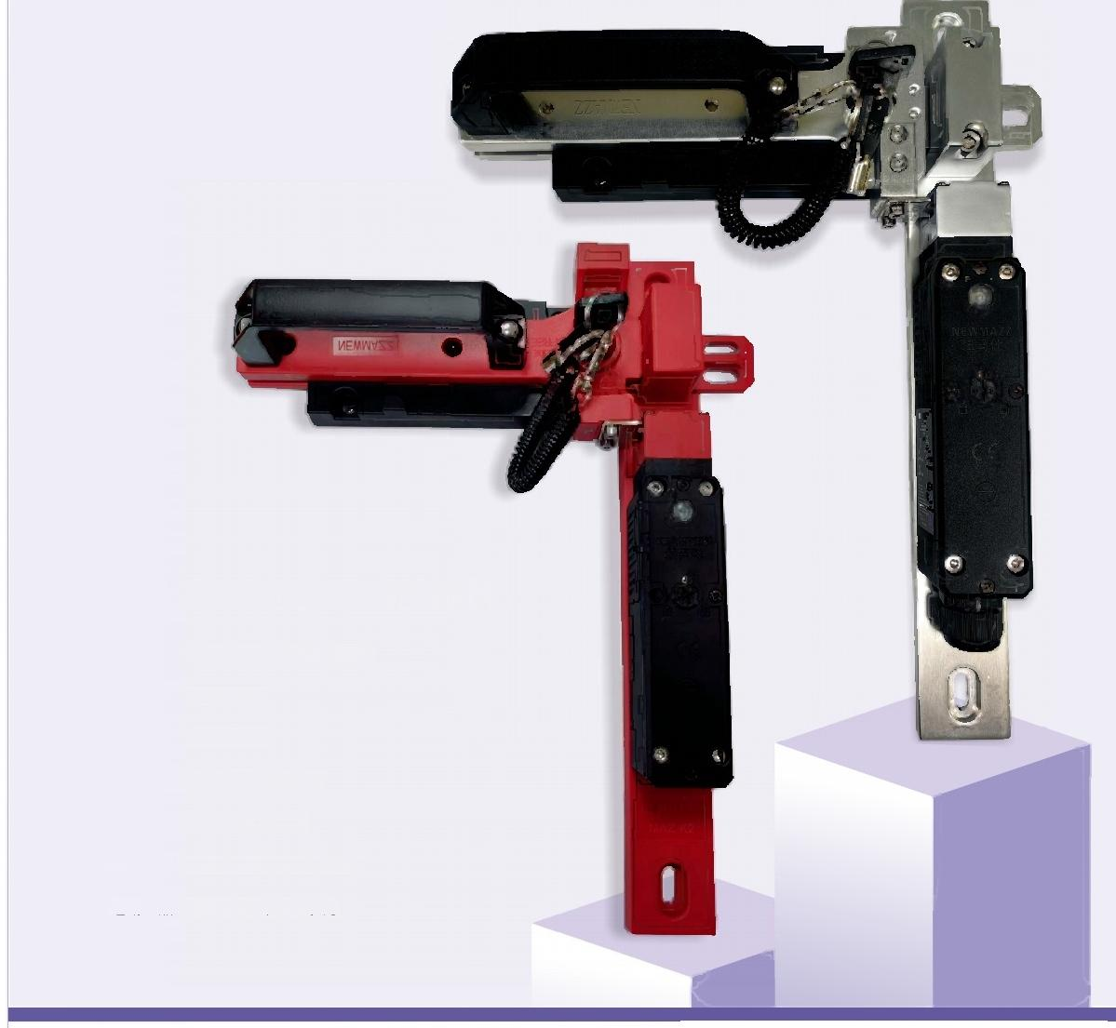
MAZ-K2 handle and bolt assembly
MAZ-K2 with MA2 / MA3
NEWMAZZ 2026
082
Notes:
Source: supplied NEWMAZZ 2026 Product Selection Manual. MAZ-K2, p. 22.

Slide 83
MAZ-K2 specifications
Parameter | Specification
Models | MAZ-K2 / MAZ-K2-Q
Main mounting base | Flame-retardant PA66 / aluminum alloy
Sliding base | Flame-retardant PA66
Bolt | Flame-retardant PA66
Handle | Aluminum alloy or flame-retardant PA66
Weight | 0.63 kg / 1.13 kg
Mounting | Left or right side of a door or protective fence
Compatible products | MA1, MA2 and MA3 series
NEWMAZZ 2026
083
Notes:
Source: supplied NEWMAZZ 2026 Product Selection Manual. MAZ-K2, p. 22.

Slide 84
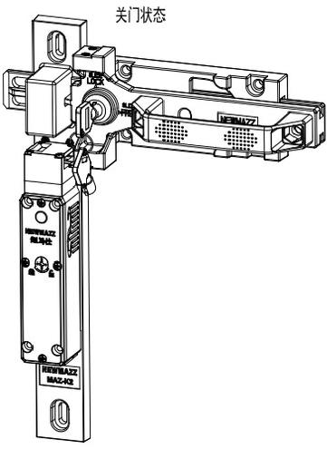
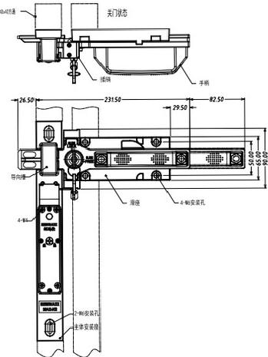
MAZ-K2 with MA3
MAZ-K2 + MA3 3D view, door closed
MAZ-K2 + MA3 dimension drawing
NEWMAZZ 2026
084
Notes:
Source: supplied NEWMAZZ 2026 Product Selection Manual. MAZ-K2, p. 23.

Slide 85
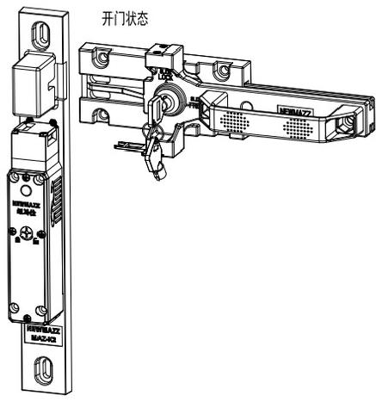
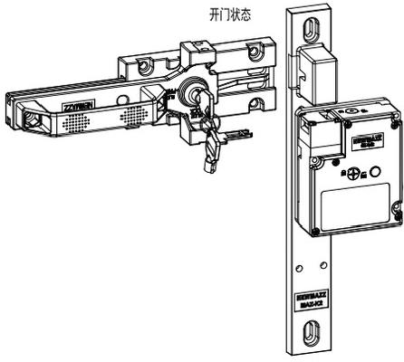
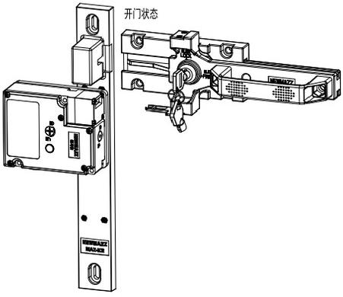
MAZ-K2 with MA2
Right-opening door, open
Left-opening door, open
Right-opening assembly
NEWMAZZ 2026
085
Notes:
Source: supplied NEWMAZZ 2026 Product Selection Manual. MAZ-K2, p. 24.

Slide 86
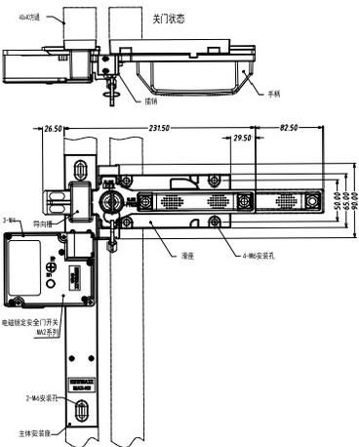
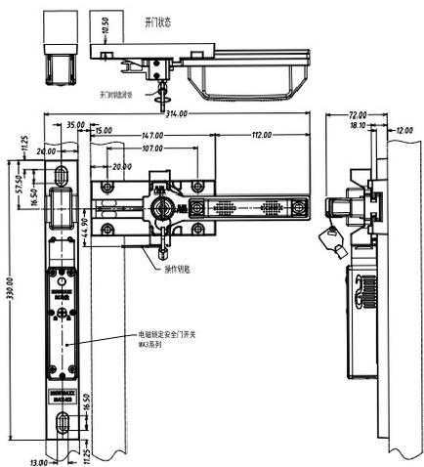
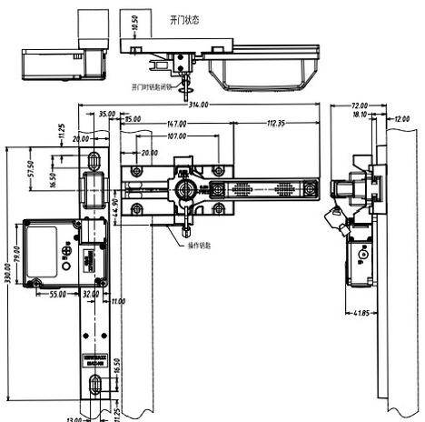
MAZ-K2 installation dimensions
Assembly dimensions
MAZ-K2 + MA2 left-opening dimensions
MAZ-K2 + MA2 right-opening dimensions
NEWMAZZ 2026
086
Notes:
Source: supplied NEWMAZZ 2026 Product Selection Manual. MAZ-K2, p. 24.

Slide 87
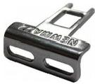
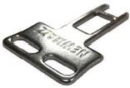
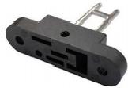
Actuator keys 1
MAZ-D1 horizontal mounting
MAZ-D2 vertical mounting
MAZ-D3 adjustable horizontal mounting
Actuator key code: MAZ-D[type].
1: horizontal / 2: vertical / 3: adjustable horizontal / 4: adjustable horizontal and vertical.
Unless otherwise specified, all dimensions have a stated tolerance of ±0.4 mm.
NEWMAZZ 2026
087
Notes:
Source: supplied NEWMAZZ 2026 Product Selection Manual. Actuator keys, p. 25.

Slide 88
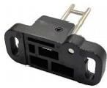

Actuator keys 2
MAZ-D4 adjustable horizontal / vertical mounting
MAZ-K6 actuator key
Actuator key code: MAZ-D[type].
1: horizontal / 2: vertical / 3: adjustable horizontal / 4: adjustable horizontal and vertical.
Unless otherwise specified, all dimensions have a stated tolerance of ±0.4 mm.
NEWMAZZ 2026
088
Notes:
Source: supplied NEWMAZZ 2026 Product Selection Manual. Actuator keys, p. 25.

Slide 89



Actuator key dimensions 1
MAZ-D1 dimensions
MAZ-D2 dimensions
MAZ-D3 dimensions
All dimensions in mm. General tolerance: ±0.4 mm unless otherwise stated.
Diagram labels include slotted mounting hole and adjustable mounting direction.
NEWMAZZ 2026
089
Notes:
Source: supplied NEWMAZZ 2026 Product Selection Manual. Actuator keys, p. 25.

Slide 90


Actuator key dimensions 2
MAZ-D4 dimensions
MAZ-K6 dimensions
All dimensions in mm. General tolerance: ±0.4 mm unless otherwise stated.
Diagram labels include slotted mounting hole and adjustable mounting direction.
NEWMAZZ 2026
090
Notes:
Source: supplied NEWMAZZ 2026 Product Selection Manual. Actuator keys, p. 25.

Slide 91



Rear release assemblies
MAZ-20 rear release assembly
MAZ-40 rear release assembly
Rear release assembly dimensions
MAZ-20: 20 mm. MAZ-40: 40 mm.
Dimension drawing for the rear release assembly.
NEWMAZZ 2026
091
Notes:
Source: supplied NEWMAZZ 2026 Product Selection Manual. Rear release assemblies, p. 26.

Slide 92

MA6 compact bolt lock
RoHS compliant.
Microprocessor controlled motor.
Low power consumption.
Mounting on either side.
Built-in solid state relay provides door / bolt open and closed signals.
MA6 small bolt type electronic lock
NEWMAZZ 2026
092
Notes:
Source: supplied NEWMAZZ 2026 Product Selection Manual. MA6, pp. 26–28.

Slide 93
MA6 model code and specifications 1
Parameter | Specification
Format | MA6-[mounting][manual release][blank option]
Mounting | F: front-mounted bolt / S: side-mounted bolt
Manual release | 1: with manual release / 2: without manual release
Compliance | RoHS
Operating voltage | 24 V DC +15% (as printed in source)
Operating current | ≤600 mA
Contact capacity | 130 mA
Response time | 60 ms
Maximum bolt release force | 110 N
Operating frequency | 0.5 Hz
NEWMAZZ 2026
093
Notes:
Source: supplied NEWMAZZ 2026 Product Selection Manual. MA6, p. 27.

Slide 94
MA6 model code and specifications 2
Parameter | Specification
Operating temperature | 0 to +60 °C
Relative humidity | 5–95%
Material | UL-certified thermoplastic
NEWMAZZ 2026
094
Notes:
Source: supplied NEWMAZZ 2026 Product Selection Manual. MA6, p. 27.

Slide 95
MA6 control operation
With a 24 V DC control signal present, the bolt retracts and remains retracted until the signal is removed.
Maximum control input current: 25 mA at 24 V DC.
Bolt extension control level: 0 V DC.
The source also mentions a minimum hold time, but the time value is missing and must be confirmed.
NEWMAZZ 2026
095
Notes:
Source: supplied NEWMAZZ 2026 Product Selection Manual. MA6 control output, p. 27.

Slide 96
MA6 wiring
Pin | Wire color | Function
1 | Brown | 0 V / GND
2 | Red | 24 V DC
3 | Orange | 24 V control signal
4 | Black | SSR open when the bolt retracts
5 | Blue | SSR conducts when the bolt extends
6 | Unused | No connection
24 V switching power supply. PLC control ON retracts the bolt. Control OFF extends the bolt. SSR contact capacity: 130 mA.
NEWMAZZ 2026
096
Notes:
Source: supplied NEWMAZZ 2026 Product Selection Manual. MA6 wiring, p. 28.
24 V switching power supply. PLC control ON retracts the bolt. Control OFF extends the bolt. SSR contact capacity: 130 mA.

Slide 97



MA6 dimensions and connector 1
Pin 1 reference
Six-pin connector allocation
Overall and mounting dimensions
Dimensions in mm. Bolt travel: 7 mm.
Optional manual release mechanism, cable excluded.
Suitable for Ø1.6 mm cable with a 4.8 mm ball end.
NEWMAZZ 2026
097
Notes:
Source: supplied NEWMAZZ 2026 Product Selection Manual. MA6 dimensions, p. 28.

Slide 98

MA6 dimensions and connector 2
Dimensions in mm. Bolt travel: 7 mm.
Optional manual release mechanism, cable excluded.
Suitable for Ø1.6 mm cable with a 4.8 mm ball end.
Panel mounting holes
NEWMAZZ 2026
098
Notes:
Source: supplied NEWMAZZ 2026 Product Selection Manual. MA6 dimensions, p. 28.

Slide 99
MA6 safe use
Do not use in flammable or explosive gas atmospheres.
Wire correctly and check normal operation before using the system. Incorrect wiring can defeat the safety function.
Qualified personnel must inspect installation, commission and maintain MA6. They must hold the qualifications needed to keep system design, installation, operation, maintenance and disposal safe.
Personnel familiar with the machine must perform and verify installation.
NEWMAZZ 2026
099
Notes:
Source: supplied NEWMAZZ 2026 Product Selection Manual. MA6 safety, p. 28.

Slide 100
MA6 inspection and power supply
Inspect MA6 daily and every six months. A malfunction can cause serious injury.
Do not disassemble, repair or modify the product.
Do not apply AC voltage or DC voltage above the rating.
To prevent electric shock, use a DC supply with double or reinforced insulation, such as a supply conforming to IEC/EN 60950 or EN 50178, or a transformer conforming to IEC/EN 61558.
The supply must satisfy Class 2 circuit requirements or the limited-voltage / limited-current circuit requirements in UL 508.
NEWMAZZ 2026
100
Notes:
Source: supplied NEWMAZZ 2026 Product Selection Manual. MA6 safety, p. 28.

Slide 101

MA50 RFID guard locking switch
A safety guard locking device locks and monitors movable guards, including fence doors and protective covers.
The MA50 uses a high-strength structure to resist pulling force and RFID sensing for secure identification. Standard coding and unique coding are available. Its compact size makes installation easier.
The device combines mechanical locking and monitoring, periodic cross-checking and independent redundant dual outputs. The 29.7 × 29.7 mm cross section mounts directly on aluminum profiles up to 30 mm without a bracket.
MA50 safety door switch
NEWMAZZ 2026
101
Notes:
Source: supplied NEWMAZZ 2026 Product Selection Manual. MA50 introduction, p. 29.

Slide 102
MA50 technical specifications 1
Parameter | Specification
Standards | EN ISO 13849-1 (Category 4 / PLe), EN ISO 14119, EN IEC 60947-5-2, EN IEC 60947-5-3
Certification | CE
Locking type | Mechanical locking / solenoid locking
Lock to unlock response | <250 ms
Unlock to lock response | <300 ms
Lock holding force Fzh | ≥2,000 N
Bolt insertion misalignment | ≤2 mm
Mechanical durability | >1,000,000 operations at a door speed of 1 m/s
Operating frequency | 1 Hz
Minimum hinged door radius | ≥250 mm
Power excludes load current. When lock control turns on, consumption briefly increases to a maximum of 15 W for approximately 50 ms.
NEWMAZZ 2026
102
Notes:
Source: supplied NEWMAZZ 2026 Product Selection Manual. MA50, p. 30.
Power excludes load current. When lock control turns on, consumption briefly increases to a maximum of 15 W for approximately 50 ms.

Slide 103
MA50 technical specifications 2
Parameter | Specification
Manual release | Front and rear
OSSD outputs | 2 × NPN / 2 × PNP
OSSD maximum load current | ≤200 mA
OSSD residual voltage ON | <2.5 V with 5 m cable
OSSD voltage OFF | ≤2 V with 5 m cable
OSSD leakage current | ≤0.5 mA
OSSD maximum capacitive load | 2 μF
Load wiring resistance | ≤2.5 Ω (unit typography unclear in source)
AUX output | 1 × NPN / 1 × PNP
AUX maximum load current | 50 mA
AUX residual voltage ON | ≤2.5 V at 50 mA
Power excludes load current. When lock control turns on, consumption briefly increases to a maximum of 15 W for approximately 50 ms.
NEWMAZZ 2026
103
Notes:
Source: supplied NEWMAZZ 2026 Product Selection Manual. MA50, p. 30.
Power excludes load current. When lock control turns on, consumption briefly increases to a maximum of 15 W for approximately 50 ms.

Slide 104
MA50 technical specifications 3
Parameter | Specification
Safety input current | 2 × 5 mA
Reset / EDM input current | Approximately 10 mA × 1
Lock control input current | Approximately 10 mA × 1
Operating voltage | 24 V DC ±20%
Power consumption | 3.6 W, excluding load current
Protection | Supply reverse polarity, output short circuit and output reverse polarity protection
Housing protection | IP65
Operating temperature | −20 to +55 °C, no icing
Storage temperature | −25 to +70 °C, no icing
Operating / storage humidity | 5–95% RH
Power excludes load current. When lock control turns on, consumption briefly increases to a maximum of 15 W for approximately 50 ms.
NEWMAZZ 2026
104
Notes:
Source: supplied NEWMAZZ 2026 Product Selection Manual. MA50, p. 30.
Power excludes load current. When lock control turns on, consumption briefly increases to a maximum of 15 W for approximately 50 ms.

Slide 105
MA50 technical specifications 4
Parameter | Specification
Vibration resistance | 10–55 Hz, 2.0 mm double amplitude, 5 min in each X, Y and Z direction (IEC 60947-5-3)
Shock resistance | 30 G, 6 impacts in each X, Y and Z direction (IEC 60947-5-3)
Cascade connection | Up to 20 units
Start-up time | 1.5 s
Material | Nylon, zinc alloy and stainless steel
Power excludes load current. When lock control turns on, consumption briefly increases to a maximum of 15 W for approximately 50 ms.
NEWMAZZ 2026
105
Notes:
Source: supplied NEWMAZZ 2026 Product Selection Manual. MA50, p. 30.
Power excludes load current. When lock control turns on, consumption briefly increases to a maximum of 15 W for approximately 50 ms.

Slide 106
MA50 ordering code
Parameter | Specification
Format | MA50-[locking][configuration][coding][output][connection]-[length]
Locking | 0: solenoid locking / 1: mechanical locking
Configuration | 0: standard / 1: advanced
Coding | 0: standard coding / 1: unique coding
Output | N: NPN / P: PNP
Connection | C: M12 connector / blank: direct cable
Cable length | 3: 3 m / 5: 5 m / 10: 10 m / 20: 20 m
NEWMAZZ 2026
106
Notes:
Source: supplied NEWMAZZ 2026 Product Selection Manual. MA50 selection, p. 31.

Slide 107
MA50 configuration functions
Configuration | OSSD | AUX | Safety inputs | Lock input | EDM / reset
Standard | Yes | Yes | Yes | Yes | —
Advanced | Yes | Yes | Yes | Yes | Yes
The source table contains incomplete marks in merged cells. Functional assignments follow the corresponding standard and advanced wiring descriptions.
NEWMAZZ 2026
107
Notes:
Source: supplied NEWMAZZ 2026 Product Selection Manual. MA50 configuration description, p. 31.
The source table contains incomplete marks in merged cells. Functional assignments follow the corresponding standard and advanced wiring descriptions.

Slide 108
MA50 model selection 1
Model | Locking | Configuration | Output | Coding
MA50-000N | Solenoid | Standard | NPN | Standard
MA50-001N | Solenoid | Standard | NPN | Unique
MA50-000P | Solenoid | Standard | PNP | Standard
MA50-001P | Solenoid | Standard | PNP | Unique
MA50-010N | Solenoid | Advanced | NPN | Standard
MA50-011N | Solenoid | Advanced | NPN | Unique
MA50-010P | Solenoid | Advanced | PNP | Standard
MA50-011P | Solenoid | Advanced | PNP | Unique
MA50-100N | Mechanical | Standard | NPN | Standard
MA50-101N | Mechanical | Standard | NPN | Unique
MA50-100P | Mechanical | Standard | PNP | Standard
MA50-101P | Mechanical | Standard | PNP | Unique
NEWMAZZ 2026
108
Notes:
Source: supplied NEWMAZZ 2026 Product Selection Manual. MA50 selection list, p. 31.

Slide 109
MA50 model selection 2
Model | Locking | Configuration | Output | Coding
MA50-110N | Mechanical | Advanced | NPN | Standard
MA50-111N | Mechanical | Advanced | NPN | Unique
MA50-110P | Mechanical | Advanced | PNP | Standard
MA50-111P | Mechanical | Advanced | PNP | Unique
NEWMAZZ 2026
109
Notes:
Source: supplied NEWMAZZ 2026 Product Selection Manual. MA50 selection list, p. 31.

Slide 110


MA50 bracket MA11-B01
Internal mounting bracket
Bracket dimensions
MA11-B01
For fixing the lock body on the inside
Dimensions in mm.
NEWMAZZ 2026
110
Notes:
Source: supplied NEWMAZZ 2026 Product Selection Manual. MA50 bracket selection, p. 32.

Slide 111


MA50 bracket MA11-BL01
Left sliding mounting bracket
Bracket dimensions
MA11-BL01
For fixing the key on a sliding door
Dimensions in mm.
NEWMAZZ 2026
111
Notes:
Source: supplied NEWMAZZ 2026 Product Selection Manual. MA50 bracket selection, p. 32.

Slide 112


MA50 bracket MA11-BR01
Right sliding mounting bracket
Bracket dimensions
MA11-BR01
For fixing the key on a sliding door
Dimensions in mm.
NEWMAZZ 2026
112
Notes:
Source: supplied NEWMAZZ 2026 Product Selection Manual. MA50 bracket selection, p. 32.

Slide 113


MA50 bracket MA11-BL02
Left rotating mounting bracket
Bracket dimensions
MA11-BL02
For fixing the key on a hinged door
Dimensions in mm.
NEWMAZZ 2026
113
Notes:
Source: supplied NEWMAZZ 2026 Product Selection Manual. MA50 bracket selection, p. 32.

Slide 114


MA50 bracket MA11-BR02
Right rotating mounting bracket
Bracket dimensions
MA11-BR02
For fixing the key on a hinged door
Dimensions in mm.
NEWMAZZ 2026
114
Notes:
Source: supplied NEWMAZZ 2026 Product Selection Manual. MA50 bracket selection, p. 32.

Slide 115



MA50 bracket dimension details 1
Internal bracket detail
Sliding bracket detail
Sliding bracket detail
NEWMAZZ 2026
115
Notes:
Source: supplied NEWMAZZ 2026 Product Selection Manual. MA50 bracket dimensions, p. 32.

Slide 116

MA50 bracket dimension details 2
Rotating bracket detail
Rotating bracket detail
Rotating bracket detail
NEWMAZZ 2026
116
Notes:
Source: supplied NEWMAZZ 2026 Product Selection Manual. MA50 bracket dimensions, p. 32.

Slide 117

MA50 bracket dimension details 3
Rotating bracket detail
Rotating bracket detail
Rotating bracket detail
NEWMAZZ 2026
117
Notes:
Source: supplied NEWMAZZ 2026 Product Selection Manual. MA50 bracket dimensions, p. 32.

Slide 118


MA50 bracket dimension details 4
Rotating bracket detail
Rotating bracket detail
Rotating bracket detail
NEWMAZZ 2026
118
Notes:
Source: supplied NEWMAZZ 2026 Product Selection Manual. MA50 bracket dimensions, p. 32.

Slide 119
MA50 bracket dimension details 5
Rotating bracket detail
NEWMAZZ 2026
119
Notes:
Source: supplied NEWMAZZ 2026 Product Selection Manual. MA50 bracket dimensions, p. 32.

Slide 120
MA50 LED indications
Indicator | Color / pattern | Meaning
Output | Green | OSSD output ON
Output | Red | OSSD output OFF
Output | Red, 2 Hz flashing | OSSD error
Output | Red, 1 Hz flashing | EDM error
Lock | Green ON | Door locked
Lock | 2 Hz flashing | Lock abnormality, solenoid or optocoupler error
Lock | 1 Hz flashing | Locked but no RFID detected
Lock | Double ON flash | Attempting to lock
Lock | Double OFF flash | Attempting to unlock
Lock | OFF | Unlocked
NEWMAZZ 2026
120
Notes:
Source: supplied NEWMAZZ 2026 Product Selection Manual. MA50 indicator explanation, p. 33.

Slide 121
MA50 input and status LEDs
Indicator | Color / pattern | Meaning
Input | Orange ON | Normal input
Input | OFF | No input, waiting for input
Input | 1 Hz flashing | Waiting for reset
Input | 2 Hz flashing | Safety input error
Operating status | Steady green | OSSD output ON
Operating status | Steady red | OSSD output OFF
Operating status | Orange, 1 Hz flashing | Voltage error
Operating status | Red / green / orange flashing | Unique code not matched
NEWMAZZ 2026
121
Notes:
Source: supplied NEWMAZZ 2026 Product Selection Manual. MA50 indicator explanation, p. 33.

Slide 122
MA50 M12 female connector pinout
Pin | Color | Standard | Advanced
1 | Brown | VCC + | VCC +
2 | Blue | GND − | GND −
3 | Gray | AUX output | AUX output
4 | Black | OSSD1 | OSSD1
5 | White | OSSD2 | OSSD2
6 | Green | Safety input 1 | Safety input 1
7 | Yellow | Safety input 2 | Safety input 2
8 | Red | Lock control | Lock control
9 | Light green | Unused | EDM
10 | Pink | Unused | Reset
11 | — | No connection | No connection
12 | — | No connection | No connection
NEWMAZZ 2026
122
Notes:
Source: supplied NEWMAZZ 2026 Product Selection Manual. MA50 wiring, p. 34.

Slide 123
MA50 lock control
Solenoid locking, mechanical release
A closed control switch locks the door. An open control switch unlocks the door.
Mechanical locking, solenoid release
An open control switch locks the door. A closed control switch unlocks the door.
Advanced configuration
When EDM is not used, short the light green EDM wire to the gray AUX wire.
Diagram references: K1 / K2 are loads. Power supply is 24 V DC and 0 V.
NEWMAZZ 2026
123
Notes:
Source: supplied NEWMAZZ 2026 Product Selection Manual. MA50 wiring notes, pp. 33–36.

Slide 124

MA50 standard wiring
Black: OSSD1. White: OSSD2. Blue: 0 V. Brown: +24 V.
Gray: AUX. Red: LOCK. Green: safety input 1. Yellow: safety input 2.
Light green and pink: unused.
Refer to the English pinout and lock control description.
Standard NPN without cascade, left. Standard PNP without cascade, right.
NEWMAZZ 2026
124
Notes:
Source: supplied NEWMAZZ 2026 Product Selection Manual. MA50 wiring, p. 33.

Slide 125

MA50 standard cascade wiring
The first switch supplies the safety inputs of the following switch.
Wire colors and functions follow the MA50 standard pinout.
Light green and pink remain unconnected.
Power supply: 24 V DC / 0 V. K1 and K2: loads.
Standard NPN cascade wiring
NEWMAZZ 2026
125
Notes:
Source: supplied NEWMAZZ 2026 Product Selection Manual. MA50 wiring, p. 34.

Slide 126

MA50 advanced wiring
Light green: EDM. Pink: Reset. Gray: AUX.
Black: OSSD1. White: OSSD2. Blue: 0 V. Brown: +24 V.
Red: LOCK. Green / yellow: safety inputs 1 / 2.
If EDM is unused, short light green (EDM) to gray (AUX).
Advanced configuration without cascade
NEWMAZZ 2026
126
Notes:
Source: supplied NEWMAZZ 2026 Product Selection Manual. MA50 wiring, p. 35.

Slide 127


MA50 advanced cascade wiring
Cascade wiring, NPN
Cascade wiring, PNP
Wire functions follow the MA50 advanced pinout.
When EDM is not used, short light green (EDM) to gray (AUX).
Lock control behavior follows the selected locking type.
Power supply: 24 V DC / 0 V. K1 and K2: loads.
NEWMAZZ 2026
127
Notes:
Source: supplied NEWMAZZ 2026 Product Selection Manual. MA50 wiring, pp. 35–36.

Slide 128


MA50 overall dimensions
Product dimensions
Release and mounting detail
All dimensions in mm.
Drawing labels identify manual release, mounting screws, actuator and conduit / connector references.
NEWMAZZ 2026
128
Notes:
Source: supplied NEWMAZZ 2026 Product Selection Manual. MA50, p. 37.

Slide 129



MA50 sliding door installation
Mounting without bracket and with internal bracket
Left-opening sliding bracket, door closed / open
Right-opening sliding bracket, door closed / open
NEWMAZZ 2026
129
Notes:
Source: supplied NEWMAZZ 2026 Product Selection Manual. MA50 installation, p. 38.

Slide 130



MA50 hinged door installation 1
Left rotating bracket installation
Left-opening rotation, door closed / open
Right rotating bracket installation
NEWMAZZ 2026
130
Notes:
Source: supplied NEWMAZZ 2026 Product Selection Manual. MA50 installation, p. 39.

Slide 131

MA50 hinged door installation 2
Right-opening rotation, door closed / open
NEWMAZZ 2026
131
Notes:
Source: supplied NEWMAZZ 2026 Product Selection Manual. MA50 installation, p. 39.

Slide 132

MA50 output diagnostic timing
Timing labels: OSSD1, OSSD2, ON and OFF.
The figure shows test pulses of ≤600 μs and timing marks of 50 ms and 100 ms.
PNP and NPN output diagnostic sequence
NEWMAZZ 2026
132
Notes:
Source: supplied NEWMAZZ 2026 Product Selection Manual. MA50 timing, p. 39.

Slide 133

MA51 MA51L MA51P magnetic locks
These switches use a flat electromagnetic locking structure to hold guard doors by magnetic force. This structure accommodates door misalignment and movement.
Their small size supports compact equipment. The source identifies low-inertia assembly equipment and cleanrooms, including semiconductor, automotive and food manufacturing, as applications.
Suitable for hinged and sliding doors.
MA51, MA51L and MA51P series
NEWMAZZ 2026
133
Notes:
Source: supplied NEWMAZZ 2026 Product Selection Manual. MA51 family, pp. 39–40.

Slide 134
MA51 family features
Parameter | Specification
Locking force | 500 N / 1,000 N
Lock structure | Compact flat electromagnetic locking surface
Cascade connection | 16–20 units
Actuator | Built-in permanent magnet
Installation | Compact housing, straightforward installation
Indication | Visible from a wide range of viewing angles
Wear | No wear powder generation
Protection | IP67
MA51 | 500 N, hinged doors
MA51L | 500 N, sliding doors
MA51P | 1,000 N
NEWMAZZ 2026
134
Notes:
Source: supplied NEWMAZZ 2026 Product Selection Manual. MA51 family, pp. 40–42.

Slide 135
MA51 family technical specifications 1
Parameter | Specification
Applicable doors | Hinged and sliding doors
Connections / versions | Compact terminal block, M12 connector, standard and advanced configurations
Operating distance Sao / Sar | 4 mm / 4 mm
Lock to unlock response | 200 ms
Unlock to lock response | 200 ms
Detected to not detected response | 20 ms + 2 ms × (number of cascaded units − 1). The label is corrupted in the source.
Not detected to detected response | 300 ms + 25 ms × (number of cascaded units − 1)
OSSD outputs | 2 transistor outputs
OSSD maximum load current | 150 mA
Residual voltage ON | Max. 2.5 V with 5 m cable / 3.5 V with 31 m cable
Voltage OFF | Max. 2.0 V with 5 m cable / 3.0 V with 31 m cable
Leakage current | Max. 0.5 mA
NEWMAZZ 2026
135
Notes:
Source: supplied NEWMAZZ 2026 Product Selection Manual. MA51 family, p. 41.

Slide 136
MA51 family technical specifications 2
Parameter | Specification
Maximum capacitive load | 4 μF
Load wiring resistance | Max. 2.5 Ω
AUX output | Transistor output, max. 50 mA
AUX residual voltage ON | Max. 2.5 V with 5 m cable / 3.5 V with 31 m cable
Safety input current | Approximately 1.5 mA × 2
Lock control / OSSD switching input | Approximately 5 mA
Reset / EDM input | Approximately 5 mA, advanced configuration only
EDM selection input | Approximately 2.5 mA, advanced configuration only
Supply voltage | 24 V DC +10%, including 10% peak-to-peak ripple, Class 2 (as printed)
Power consumption | <5 W
Protective circuits | Supply reverse polarity, output short circuit and output reverse polarity protection
Housing protection | IP67
NEWMAZZ 2026
136
Notes:
Source: supplied NEWMAZZ 2026 Product Selection Manual. MA51 family, p. 41.

Slide 137
MA51 family technical specifications 3
Parameter | Specification
Operating temperature | −10 to +55 °C, no icing
Storage temperature | −25 to +70 °C, no icing
Operating / storage humidity | 5–95% RH
Vibration resistance | 10–55 Hz, 2.0 mm double amplitude, 5 min in each X, Y and Z direction, IEC 60947-5-3
Shock resistance | 30 G, 6 impacts in each X, Y and Z direction, IEC 60947-5-3
Standards | EN ISO 13849-1:2015 (PLe, Category 4), IEC 60947-5-3, EN 60947-5-3
NEWMAZZ 2026
137
Notes:
Source: supplied NEWMAZZ 2026 Product Selection Manual. MA51 family, p. 41.

Slide 138
MA51 family ordering code
Parameter | Specification
Example structure | MA51L-[locking][configuration][coding][output][connection]
Product series | MA51 / MA51L / MA51P
Locking | 0: electromagnetic locking
Configuration | 0: standard / 1: advanced
Coding | 0: standard coding / 1: unique coding
Output | N: NPN / P: PNP
Connection | C: M12 connector / T: terminal block
Terminal block availability | MA51 only
NEWMAZZ 2026
138
Notes:
Source: supplied NEWMAZZ 2026 Product Selection Manual. MA51 family model explanation, p. 42.

Slide 139
MA51 family configuration functions
Configuration | Safety / AUX outputs | Safety / lock inputs | EDM / reset | EDM select
Standard | Available | Available | — | —
Advanced | Available | Available | Available | Available
NEWMAZZ 2026
139
Notes:
Source: supplied NEWMAZZ 2026 Product Selection Manual. MA51 family, p. 42.

Slide 140
MA51 terminal block model selection
Model | Configuration | Output | Coding
MA51-000NT | Terminal block | NPN | Standard
MA51-001NT | Terminal block | NPN | Unique
MA51-000PT | Terminal block | PNP | Standard
MA51-001PT | Terminal block | PNP | Unique
NEWMAZZ 2026
140
Notes:
Source: supplied NEWMAZZ 2026 Product Selection Manual. MA51 family, p. 42.

Slide 141
MA51 family standard selection
Output | Coding | MA51 | MA51L | MA51P
NPN | Standard | MA51-000NC | MA51L-000NC | MA51P-000NC
NPN | Unique | MA51-001NC | MA51L-001NC | MA51P-001NC
PNP | Standard | MA51-000PC | MA51L-000PC | MA51P-000PC
PNP | Unique | MA51-001PC | MA51L-001PC | MA51P-001PC
Electromagnetic locking. Some source model strings contain OCR artifacts. The table follows the stated model code structure.
NEWMAZZ 2026
141
Notes:
Source: supplied NEWMAZZ 2026 Product Selection Manual. MA51 family, p. 42.
Electromagnetic locking. Some source model strings contain OCR artifacts. The table follows the stated model code structure.

Slide 142
MA51 family advanced selection
Output | Coding | MA51 | MA51L | MA51P
NPN | Standard | MA51-010NC | MA51L-010NC | MA51P-010NC
NPN | Unique | MA51-011NC | MA51L-011NC | MA51P-011NC
PNP | Standard | MA51-010PC | MA51L-010PC | MA51P-010PC
PNP | Unique | MA51-011PC | MA51L-011PC | MA51P-011PC
Electromagnetic locking. Some source model strings contain OCR artifacts. The table follows the stated model code structure.
NEWMAZZ 2026
142
Notes:
Source: supplied NEWMAZZ 2026 Product Selection Manual. MA51 family, p. 42.
Electromagnetic locking. Some source model strings contain OCR artifacts. The table follows the stated model code structure.

Slide 143
MA51 family 12-pin M12 wiring
Pin | Wire color | Function
1 | Brown | VCC +
2 | Blue | GND −
3 | Gray | AUX output 1
4 | Black | OSSD1
5 | White | OSSD2
6 | Green | Safety input 1
7 | Yellow | Safety input 2
8 | Red | Lock control
9 | Light green | Reset / EDM
10 | Pink | EDM selection
11 | Orange | AUX output 2
12 | Purple | OSSD operating mode selection
NEWMAZZ 2026
143
Notes:
Source: supplied NEWMAZZ 2026 Product Selection Manual. Cable selection and wiring, p. 47.

Slide 144
MA51 family OSSD and EDM settings
OSSD operating mode selection
NPN: connect the purple wire to 0 V for operation linked to door opening / closing.
PNP: connect the purple wire to +24 V for operation linked to door opening / closing.
Leave the purple wire open for operation linked to locking.
EDM and reset
To use both functions, follow the wiring diagrams.
When neither function is used, connect pink (EDM selection) and light green (Reset / EDM) to +24 V for NPN or 0 V for PNP.
To use EDM alone, leave the pink EDM selection wire open.
NEWMAZZ 2026
144
Notes:
Source: supplied NEWMAZZ 2026 Product Selection Manual. MA51 family wiring notes, pp. 43–46.

Slide 145


MA51 family standard wiring without cascade
Standard PNP / NPN drawing
Standard wiring drawing
Power supply: 24 V DC / 0 V.
Wire functions follow the English 12-pin table.
K1 / K2: external devices, such as forcibly guided relays and electromagnetic contactors. S: reset switch.
Refer to the OSSD and EDM settings for purple, pink and light green wire connections.
NEWMAZZ 2026
145
Notes:
Source: supplied NEWMAZZ 2026 Product Selection Manual. MA51 family wiring, pp. 43–46.

Slide 146


MA51 family standard cascade wiring
Standard NPN cascade
Standard PNP cascade
Power supply: 24 V DC / 0 V.
Wire functions follow the English 12-pin table.
K1 / K2: external devices, such as forcibly guided relays and electromagnetic contactors. S: reset switch.
Refer to the OSSD and EDM settings for purple, pink and light green wire connections.
NEWMAZZ 2026
146
Notes:
Source: supplied NEWMAZZ 2026 Product Selection Manual. MA51 family wiring, pp. 43–46.

Slide 147


MA51 family advanced wiring without cascade
Advanced PNP without cascade
Advanced NPN without cascade
Power supply: 24 V DC / 0 V.
Wire functions follow the English 12-pin table.
K1 / K2: external devices, such as forcibly guided relays and electromagnetic contactors. S: reset switch.
Refer to the OSSD and EDM settings for purple, pink and light green wire connections.
NEWMAZZ 2026
147
Notes:
Source: supplied NEWMAZZ 2026 Product Selection Manual. MA51 family wiring, pp. 43–46.

Slide 148


MA51 family advanced cascade wiring
Advanced PNP cascade
Advanced NPN cascade
Power supply: 24 V DC / 0 V.
Wire functions follow the English 12-pin table.
K1 / K2: external devices, such as forcibly guided relays and electromagnetic contactors. S: reset switch.
Refer to the OSSD and EDM settings for purple, pink and light green wire connections.
NEWMAZZ 2026
148
Notes:
Source: supplied NEWMAZZ 2026 Product Selection Manual. MA51 family wiring, pp. 43–46.

Slide 149



MA51 family terminal block wiring 1
Terminal layout
MA51 terminal block PNP
MA51 terminal block NPN
Power supply: 24 V DC / 0 V.
Wire functions follow the English 12-pin table.
K1 / K2: external devices, such as forcibly guided relays and electromagnetic contactors. S: reset switch.
Refer to the OSSD and EDM settings for purple, pink and light green wire connections.
NEWMAZZ 2026
149
Notes:
Source: supplied NEWMAZZ 2026 Product Selection Manual. MA51 family wiring, pp. 43–46.

Slide 150


MA51 family terminal block wiring 2
Terminal block cascade diagram
Terminal block cascade diagram
Power supply: 24 V DC / 0 V.
Wire functions follow the English 12-pin table.
K1 / K2: external devices, such as forcibly guided relays and electromagnetic contactors. S: reset switch.
Refer to the OSSD and EDM settings for purple, pink and light green wire connections.
NEWMAZZ 2026
150
Notes:
Source: supplied NEWMAZZ 2026 Product Selection Manual. MA51 family wiring, pp. 43–46.

Slide 151
MA50 cable selection
Parameter | Specification
Cable code | MA50-C[connector][length]
Connector L | Bare wires at one end, right-angle female circular connector at the other
Connector S | Bare wires at one end, straight female circular connector at the other
Lengths | 1 m, 3 m, 5 m, 10 m and 20 m
Compatibility | MA51, MA51L and MA51P family. The selection illustrations also list MA50.
NEWMAZZ 2026
151
Notes:
Source: supplied NEWMAZZ 2026 Product Selection Manual. Cable selection, p. 47.

Slide 152
Cable model selection
Length | Straight connector | Right-angle connector
1 m | MA50-CS1 | MA50-CL1
3 m | MA50-CS3 | MA50-CL3
5 m | MA50-CS5 | MA50-CL5
10 m | MA50-CS10 | MA50-CL10
20 m | MA50-CS20 | MA50-CL20
NEWMAZZ 2026
152
Notes:
Source: supplied NEWMAZZ 2026 Product Selection Manual. Cable selection, p. 47.

Slide 153

M12 cable connector
The soldering wire colors and functions appear in the English 12-pin wiring table.
Connector pin numbering follows the original view.
12-pin waterproof female circular connector pin numbering
NEWMAZZ 2026
153
Notes:
Source: supplied NEWMAZZ 2026 Product Selection Manual. Cable connector, p. 47.

Slide 154

MA51L product dimensions
Dimensions in mm. Drawing labels include the rear sensing center and mounting center.
MA51L overall, actuator and mounting dimensions
NEWMAZZ 2026
154
Notes:
Source: supplied NEWMAZZ 2026 Product Selection Manual. MA51L, p. 48.

Slide 155



MA51L installation alignment 1
Correct aligned sensing faces
Sensing center and magnetic center
Incorrect 90° alignment
Maximum gap: 2.5 mm. Maximum tilt: 4°.
The flexible actuator structure accommodates a sensing-center / magnetic-center offset within 5 mm.
The lock body and actuator sensing faces must directly face each other.
NEWMAZZ 2026
155
Notes:
Source: supplied NEWMAZZ 2026 Product Selection Manual. MA51L installation example, p. 48.

Slide 156


MA51L installation alignment 2
Incorrect offset or tilted alignment
Incorrect 180° alignment
Maximum gap: 2.5 mm. Maximum tilt: 4°.
The flexible actuator structure accommodates a sensing-center / magnetic-center offset within 5 mm.
The lock body and actuator sensing faces must directly face each other.
NEWMAZZ 2026
156
Notes:
Source: supplied NEWMAZZ 2026 Product Selection Manual. MA51L installation example, p. 48.

Slide 157

MA51L mounting brackets
Bracket installation.
Assembly labels: door frame, actuator, mounting plate and main body.
Actuator mounted to a movable frame or movable panel
NEWMAZZ 2026
157
Notes:
Source: supplied NEWMAZZ 2026 Product Selection Manual. MA51L mounting, p. 49.

Slide 158



MA51L selection sequence 1
Step 1: MA51L switch body
Step 2: MA51L actuator
Step 3: MA51L-B-8-9-10 mounting bracket
The illustrated connector cables are compatible with MA50, MA51L and MA51P.
NEWMAZZ 2026
158
Notes:
Source: supplied NEWMAZZ 2026 Product Selection Manual. MA51L selection method, p. 49.

Slide 159

MA51L selection sequence 2
The illustrated connector cables are compatible with MA50, MA51L and MA51P.
Step 4: MA50-CS3 / CS5 connector cable
NEWMAZZ 2026
159
Notes:
Source: supplied NEWMAZZ 2026 Product Selection Manual. MA51L selection method, p. 49.

Slide 160


MA51P product dimensions
Actuator dimensions
Main body dimensions
All dimensions in mm.
NEWMAZZ 2026
160
Notes:
Source: supplied NEWMAZZ 2026 Product Selection Manual. MA51P, p. 50.

Slide 161



MA51P installation alignment
Correct and incorrect sensing-face alignment
Actuator mounting without bracket
Actuator mounting with bracket
Correct: lock body and actuator sensing faces directly face each other.
Incorrect: sensing faces rotated by 90° or 180°, or not on the same plane.
Assembly labels: door frame, actuator, mounting plate and main body.
NEWMAZZ 2026
161
Notes:
Source: supplied NEWMAZZ 2026 Product Selection Manual. MA51P, p. 51.

Slide 162



MA51P selection sequence 1
Step 1: MA51P switch body
Step 2: MA51P actuator
Step 3: MA51P-B mounting bracket
The illustrated connector cables are compatible with MA50, MA51L and MA51P.
NEWMAZZ 2026
162
Notes:
Source: supplied NEWMAZZ 2026 Product Selection Manual. MA51P selection method, p. 51.

Slide 163

MA51P selection sequence 2
The illustrated connector cables are compatible with MA50, MA51L and MA51P.
Step 4: MA50-CS3 / CS5 connector cable
NEWMAZZ 2026
163
Notes:
Source: supplied NEWMAZZ 2026 Product Selection Manual. MA51P selection method, p. 51.

Slide 164


MA51 product dimensions
Actuator dimensions
Main body dimensions
All dimensions in mm. Main body and actuator dimensions follow the original drawings.
NEWMAZZ 2026
164
Notes:
Source: supplied NEWMAZZ 2026 Product Selection Manual. MA51, p. 52.

Slide 165



MA51 installation and indicators 1
Incorrect sensing-face orientation
MA51L status indications
Mounting reference plane and centerline
Correct: lock body and actuator sensing faces directly face each other.
Door closed, unlocked: green flashing.
Door closed, locked: steady green.
Door open: steady red.
NEWMAZZ 2026
165
Notes:
Source: supplied NEWMAZZ 2026 Product Selection Manual. Installation and indicators, p. 53.

Slide 166



MA51 installation and indicators 2
Incorrect sensing faces on different planes
Incorrect 180° orientation
MA51P status indications
Correct: lock body and actuator sensing faces directly face each other.
Door closed, unlocked: green flashing.
Door closed, locked: steady green.
Door open: steady red.
NEWMAZZ 2026
166
Notes:
Source: supplied NEWMAZZ 2026 Product Selection Manual. Installation and indicators, p. 53.

Slide 167


MA51 installation method
Actuator with mounting bracket
Actuator without mounting bracket
Assembly labels: door frame, actuator, mounting plate and main body.
NEWMAZZ 2026
167
Notes:
Source: supplied NEWMAZZ 2026 Product Selection Manual. MA51 installation, p. 54.

Slide 168


MA51 selection and indications
Step 1 switch body, Step 2 actuator, Step 3 bracket, Step 4 cable
Door closed unlocked, closed locked, and open
Select MA51 switch body, actuator, MA51-B bracket and MA50-CS3 / CS5 connector cable. The source labels the actuator “MA21” in this selection illustration.
Green flashing: closed and unlocked. Steady green: closed and locked. Steady red: open.
Connector cables: MA50 / MA51L / MA51P compatible as listed in the source.
NEWMAZZ 2026
168
Notes:
Source: supplied NEWMAZZ 2026 Product Selection Manual. MA51 selection, p. 54.

Slide 169

MAS01 non-contact RFID switch
The series meets ISO 13849-1 requirements. Dual safety channel outputs can reach PLe and help prevent missed or false detection.
Up to 30 switches can connect for medium and large equipment. LED indication reduces fault diagnosis time.
Unique coding provides secure identification. The design resists interference and supports mounting on either side.
MAS01 compact RFID safety door switch
NEWMAZZ 2026
169
Notes:
Source: supplied NEWMAZZ 2026 Product Selection Manual. MAS01, pp. 55–56.

Slide 170
MAS01 ordering code
Parameter | Specification
Format | MAS01-[coding][output][cable length]
Product type | Standard switch / actuator, normally closed or normally open
Coding | 0: standard coding / 1: unique coding
Output C / D | C: dual NPN / D: dual PNP
Output CN / DP | CN: dual NPN with cascade / DP: dual PNP with cascade
Cable length | 1: 1 m / 2: 2 m / 5: 5 m
NEWMAZZ 2026
170
Notes:
Source: supplied NEWMAZZ 2026 Product Selection Manual. MAS01, p. 55.

Slide 171
MAS01 specifications
Parameter | Specification
Safety standards | ISO 13849-1, IEC/EN 60947-5-3
Safety classification | Category 4 under ISO 13849-1, suitable for PLe / PLd
Horizontal / vertical ON distance | 0–10 mm / 0–8 mm
Operating voltage | 24 V DC +15% (as printed)
Operating current | 30 mA
Output current | 150 mA
Response time | 60 ms
Protection | IP65, IP67 / IP68 available on request
Operating frequency | 1 Hz
Operating temperature | −10 to +55 °C
Relative humidity | 5–95%
Material | UL-certified thermoplastic
NEWMAZZ 2026
171
Notes:
Source: supplied NEWMAZZ 2026 Product Selection Manual. MAS01, p. 55.

Slide 172

MAS01 overall and mounting dimensions
Dimensions in mm. Drawing labels: target mark, cable, sensing face, indicator and 2 × M3 mounting points.
MAS01 switch and actuator dimensions
NEWMAZZ 2026
172
Notes:
Source: supplied NEWMAZZ 2026 Product Selection Manual. MAS01, p. 56.

Slide 173

MAS01 sensing alignment
Align the target marks so the switch sensing face directly faces the actuator sensing face.
Operating distance means the separation between the two sensing faces.
The values are typical at 23 °C. Actual values vary with nearby metal, magnetic attraction and temperature.
Detection may also occur outside the designated sensing faces. Align correctly before use.
Sensing face and target mark
NEWMAZZ 2026
173
Notes:
Source: supplied NEWMAZZ 2026 Product Selection Manual. MAS01, p. 57.

Slide 174
MAS01 sensing range
Alignment | X offset | ON range | OFF range
Horizontal | Within ±4 mm | Y: 0–10 mm | Y: >25 mm
Vertical | Within ±4 mm | Z: 0–8 mm | Z: >23 mm
Either | X >5 mm or X <−5 mm | Outside range | Do not use
The source prints +4 mm for the alignment band. Confirm the tolerance if critical.
NEWMAZZ 2026
174
Notes:
Source: supplied NEWMAZZ 2026 Product Selection Manual. MAS01, p. 57.
The source prints +4 mm for the alignment band. Confirm the tolerance if critical.

Slide 175
MAS01 wire definitions
No. | Color | Signal / function
1 | Brown | Output A1, safety output 1 as labeled
2 | Blue | Output A2, safety output 2 as labeled
3 | Black | Output B1, safety output 1
4 | White | Output B2, safety output 2
5 | Green | Output C1, cascade output 1
6 | Yellow | Output C2, cascade output 2
Signal names in the source table are partly inconsistent with its diagram. The original drawing is retained.
NEWMAZZ 2026
175
Notes:
Source: supplied NEWMAZZ 2026 Product Selection Manual. MAS01, p. 57.
Signal names in the source table are partly inconsistent with its diagram. The original drawing is retained.

Slide 176


MAS01 relay connection examples
MAS01 six-wire cable
Dual output and dual output with cascade, NPN and PNP
RFID switch connected to a safety relay module.
F1: external fuse protection. S2: reset button. K3 / K4: safety contactors.
Supply: 24 V DC / 0 V.
NPN and PNP examples with and without cascade.
NEWMAZZ 2026
176
Notes:
Source: supplied NEWMAZZ 2026 Product Selection Manual. MAS01, pp. 57–58.

Slide 177


MAS01 cascade wiring
Dual output wiring example
Dual output wiring with cascade
Wire labels: brown, blue, black, white, green and yellow.
K1 / K2 and load symbols identify external loads.
Follow the switch variant and corresponding safety relay wiring diagram.
NEWMAZZ 2026
177
Notes:
Source: supplied NEWMAZZ 2026 Product Selection Manual. MAS01, p. 59.

Slide 178
MAS01 LED indications
LED pattern | Input | Output | Meaning
Steady red | Valid / invalid | OFF | No actuator or incomplete alignment, unique coding
Red ON 1 s, then 2 flashes | Valid / invalid | OFF | No actuator or incomplete alignment, standard coding
Red 4 Hz flashing | Valid | OFF | Output overload
Green 1 Hz flashing | Invalid | OFF | No input signal, not applicable to dual-output version
Steady green | Valid | ON | Normal detection
Alternating red / green | Valid | OFF | Tag not registered
NEWMAZZ 2026
178
Notes:
Source: supplied NEWMAZZ 2026 Product Selection Manual. MAS01, p. 59.

Slide 179
MAS01 safe use
Disconnect MA9Z power before wiring MAS01. Connected devices may otherwise operate unexpectedly.
Do not use in flammable or explosive gas atmospheres.
Wire correctly and confirm normal operation before use.
The auxiliary output is not a safety output. Using it as one defeats the safety functions of MAS01 and its connected equipment.
Qualified personnel must inspect the installation, commission and maintain the unit, with qualifications covering design, installation, operation, maintenance and disposal.
NEWMAZZ 2026
179
Notes:
Source: supplied NEWMAZZ 2026 Product Selection Manual. MAS01, p. 59.

Slide 180
MAS01 inspection and system integration
Personnel familiar with the machine must perform and verify installation.
Inspect MAS01 daily and every six months. Malfunction can cause serious injury.
Do not disassemble, repair or modify the product. Do not apply AC or DC voltage above the rating.
Use a DC supply with double or reinforced insulation, for example IEC/EN 60950 or EN 50178, or a transformer to IEC/EN 61558. The supply must satisfy Class 2 or UL 508 limited-voltage / limited-current requirements.
Connect only to components meeting the required safety level. The entire system must meet that level. Consult an authoritative certification body about conformity assessment.
NEWMAZZ 2026
180
Notes:
Source: supplied NEWMAZZ 2026 Product Selection Manual. MAS01, p. 59.

Slide 181

MAS02 non-contact safety switch
A non-contact safety door switch confirms whether movable guards, including fence doors and protective covers, are open or closed.
MAS02 uses RFID sensing for secure identification. Standard and unique coding are available. Its compact size simplifies installation.
Periodic self-checking and cross-checking improve safety. Independent redundant dual outputs reduce the risk from failure of a single circuit.
MAS02 series
NEWMAZZ 2026
181
Notes:
Source: supplied NEWMAZZ 2026 Product Selection Manual. MAS02, p. 60.

Slide 182
MAS02 technical specifications 1
Parameter | Specification
Standards | ISO 13849-1 / IEC/EN 60947-5-3
Power supply | 24 V DC +15% (as printed)
Power consumption | <1 W
Response time | 50 ms
Output current | 150 mA
OSSD safety outputs | PNP or NPN transistor. Load ≤200 mA, residual voltage ≤1 V excluding cable-extension voltage drop, leakage ≤1 mA.
Operating frequency | 1 Hz
Protection circuits | Supply overvoltage, reverse polarity and output overcurrent
Coding | Standard / unique
Horizontal / vertical ON distance | 0–10 mm / 0–5 mm
The source lists 150 mA output current and a 200 mA OSSD load limit. Both are retained.
NEWMAZZ 2026
182
Notes:
Source: supplied NEWMAZZ 2026 Product Selection Manual. MAS02, p. 61.
The source lists 150 mA output current and a 200 mA OSSD load limit. Both are retained.

Slide 183
MAS02 technical specifications 2
Parameter | Specification
Housing protection | IP65
Cross-section dimensions | 36 × 23 mm (technical table)
Vibration | 10–55 Hz, amplitude 0.35 ±0.05 mm, 20 cycles in each X, Y and Z direction
Operating temperature | −10 to +55 °C, no condensation
Storage temperature | −30 to +70 °C, no condensation
Humidity | <85% RH at 20 °C
The source lists 150 mA output current and a 200 mA OSSD load limit. Both are retained.
NEWMAZZ 2026
183
Notes:
Source: supplied NEWMAZZ 2026 Product Selection Manual. MAS02, p. 61.
The source lists 150 mA output current and a 200 mA OSSD load limit. Both are retained.

Slide 184
MAS02 ordering code
Parameter | Specification
Format | MAS02-[configuration][coding][output]-[length]
Configuration | 0: basic / 1: standard
Coding | 0: standard / 1: unique
Output | N: NPN / P: PNP
Cable length | 1: 1 m / 2: 2 m
Basic / standard functions | Basic: safety outputs. Standard: safety outputs and cascade.
NEWMAZZ 2026
184
Notes:
Source: supplied NEWMAZZ 2026 Product Selection Manual. MAS02, p. 61.

Slide 185
MAS02 model selection
Model | Version | Output | Coding
MAS02-00N | Basic | NPN | Standard
MAS02-01N | Basic | NPN | Unique
MAS02-00P | Basic | PNP | Standard
MAS02-01P | Basic | PNP | Unique
MAS02-10N | Standard | NPN | Standard
MAS02-11N | Standard | NPN | Unique
MAS02-10P | Standard | PNP | Standard
MAS02-11P | Standard | PNP | Unique
NEWMAZZ 2026
185
Notes:
Source: supplied NEWMAZZ 2026 Product Selection Manual. MAS02, p. 61.

Slide 186

MAS02 structural dimensions
All dimensions in mm.
The catalog lists overall dimensions as 48 × 25.5 × 12 mm.
MAS02 switch and actuator dimensions
NEWMAZZ 2026
186
Notes:
Source: supplied NEWMAZZ 2026 Product Selection Manual. MAS02, p. 62.

Slide 187
MAS02 LED indications
Switch state | LED pattern
Output error | Red flashing at 1 Hz
Voltage error | Red double flash
Unique code not paired | Alternating red / green at 4 Hz
No error, no RFID, no output | Steady red
RFID present, no cascade signal | Green flashing at 1 Hz
RFID present, cascade signal error | Green double flash
Normal detection and output | Steady green
NEWMAZZ 2026
187
Notes:
Source: supplied NEWMAZZ 2026 Product Selection Manual. MAS02, p. 63.

Slide 188
MAS02 wire labels
Color | Function | Connection
Brown | Positive supply | Connect to +24 V DC
Blue | Negative supply | Connect to 0 V DC
Black | Safety output 1 | Connect to safety PLC or another safety input interface
White | Safety output 2 | Connect to safety PLC or another safety input interface
Green | Safety input 1 | Cascade connection to switch OSSD safety signals
Yellow | Safety input 2 | Cascade connection to switch OSSD safety signals
NEWMAZZ 2026
188
Notes:
Source: supplied NEWMAZZ 2026 Product Selection Manual. MAS02, pp. 63–64.

Slide 189

MAS02 wiring
Basic NPN / PNP and standard NPN / PNP versions.
Basic: black OSSD1, white OSSD2, blue 0 V and brown +24 V.
Standard: also green safety input 1 and yellow safety input 2.
Load 1 and load 2 connect to the OSSD channels. Supply: 24 V DC / 0 V.
MAS02 wiring diagram
NEWMAZZ 2026
189
Notes:
Source: supplied NEWMAZZ 2026 Product Selection Manual. MAS02, pp. 63–64.

Slide 190

MAS03 magnetic holding safety switch
A non-contact magnetic holding safety switch confirms the open or closed state of movable guards.
MAS03 uses RFID detection for secure identification, with standard or unique coding. Its compact size simplifies installation.
Periodic self-checking and cross-checking improve safety. Independent redundant outputs reduce the risk of single-circuit failure. Magnetic holding force reaches 15 N and can replace a separate door magnet.
MAS03 high-performance safety switch
NEWMAZZ 2026
190
Notes:
Source: supplied NEWMAZZ 2026 Product Selection Manual. MAS03, p. 65.

Slide 191
MAS03 technical specifications 1
Parameter | Specification
Standards | ISO 13849-1 (Category 4 / PLe), IEC/EN 60947-5-1, IEC/EN 60947-5-3
Power supply | 24 V DC +15% (as printed)
Power consumption | <1 W
Risk time / response time | 50 ms / 50 ms
Magnetic holding force | >15 N
Operating frequency | 1 Hz
OSSD outputs | PNP or NPN transistor. Load ≤200 mA, residual voltage ≤1 V excluding cable-extension voltage drop, leakage ≤1 mA.
Protection circuits | Supply overvoltage, reverse polarity and output overcurrent
Coding | Standard / unique
Housing protection | IP65
Cross section | 48 × 30 mm
NEWMAZZ 2026
191
Notes:
Source: supplied NEWMAZZ 2026 Product Selection Manual. MAS03, p. 66.

Slide 192
MAS03 technical specifications 2
Parameter | Specification
Vibration | 10–55 Hz, amplitude 0.35 +0.05 mm as printed, 20 cycles in each X, Y and Z direction
Operating temperature | −10 to +55 °C, no condensation
Storage temperature | −30 to +70 °C, no condensation
Humidity | <85% RH at 20 °C
NEWMAZZ 2026
192
Notes:
Source: supplied NEWMAZZ 2026 Product Selection Manual. MAS03, p. 66.

Slide 193
MAS03 ordering code
Parameter | Specification
Format | MAS03-[configuration][coding][output][connection]-[length]
Configuration | 0: basic / 1: standard / 2: advanced
Coding | 0: standard / 1: unique
Output | N: NPN / P: PNP
Connection | C: M12 / blank: direct cable
Cable lengths | 3: 3 m / 5: 5 m / 10: 10 m / 20: 20 m
NEWMAZZ 2026
193
Notes:
Source: supplied NEWMAZZ 2026 Product Selection Manual. MAS03, p. 66.

Slide 194
MAS03 functions
Version | Safety outputs | Cascade | EDM | Reset | AUX
Basic | Yes | — | — | — | —
Standard | Yes | Yes | — | — | —
Advanced | Yes | Yes | Yes | Yes | Yes
The source has incomplete marks in merged cells. Advanced diagrams identify EDM, reset and AUX.
NEWMAZZ 2026
194
Notes:
Source: supplied NEWMAZZ 2026 Product Selection Manual. MAS03, p. 66.
The source has incomplete marks in merged cells. Advanced diagrams identify EDM, reset and AUX.

Slide 195
MAS03 model selection
Model | Version | Output | Coding
MAS03-00N | Basic | NPN | Standard
MAS03-01N | Basic | NPN | Unique
MAS03-00P | Basic | PNP | Standard
MAS03-01P | Basic | PNP | Unique
MAS03-10N | Standard | NPN | Standard
MAS03-11N | Standard | NPN | Unique
MAS03-10P | Standard | PNP | Standard
MAS03-11P | Standard | PNP | Unique
MAS03-20N | Advanced | NPN | Standard
MAS03-21N | Advanced | NPN | Unique
MAS03-20P | Advanced | PNP | Standard
MAS03-21P | Advanced | PNP | Unique
NEWMAZZ 2026
195
Notes:
Source: supplied NEWMAZZ 2026 Product Selection Manual. MAS03, p. 67.

Slide 196



MAS03 dimensions and mounting 1
Sensor dimensions
Actuator dimensions
Indicator location
Dimensions in mm.
NEWMAZZ 2026
196
Notes:
Source: supplied NEWMAZZ 2026 Product Selection Manual. MAS03, p. 67.

Slide 197


MAS03 dimensions and mounting 2
Sensor mounting holes
Actuator mounting holes
Dimensions in mm.
NEWMAZZ 2026
197
Notes:
Source: supplied NEWMAZZ 2026 Product Selection Manual. MAS03, p. 67.

Slide 198
MAS03 LED indications
Switch state | LED pattern
EEPROM / SPI error | Red 4 Hz
Output / EDM error | Red 1 Hz
Voltage error | Red double flash
Unique code not paired | Alternating red / green 4 Hz
No RFID, no output | Steady red
RFID and cascade present, waiting for reset | Green 4 Hz
RFID present, no cascade signal | Green 1 Hz
RFID present, cascade signal error | Green double flash
All conditions met, output ON | Steady green
NEWMAZZ 2026
198
Notes:
Source: supplied NEWMAZZ 2026 Product Selection Manual. MAS03, p. 68.

Slide 199



MAS03 installation and timing 1
Correct alignment
Actuator orientation
Sensor orientation
Use the correct installation direction. Misaligned sensing faces or faces on different planes are incorrect.
Timing labels: OSSD1 and OSSD2. The figures show >200 μs, 50 ms and 100 ms.
NEWMAZZ 2026
199
Notes:
Source: supplied NEWMAZZ 2026 Product Selection Manual. MAS03, p. 68.

Slide 200


MAS03 installation and timing 2
PNP diagnostic sequence
NPN diagnostic sequence
Use the correct installation direction. Misaligned sensing faces or faces on different planes are incorrect.
Timing labels: OSSD1 and OSSD2. The figures show >200 μs, 50 ms and 100 ms.
NEWMAZZ 2026
200
Notes:
Source: supplied NEWMAZZ 2026 Product Selection Manual. MAS03, p. 68.

Slide 201
MAS03 wire labels
Color | Function | Connection
Brown | Positive supply | Connect to +24 V DC
Blue | Negative supply | Connect to 0 V DC
Black | Safety output 1 | Connect to safety PLC or another safety input interface
White | Safety output 2 | Connect to safety PLC or another safety input interface
Green | Safety input 1 | Cascade connection to switch OSSD safety signals
Yellow | Safety input 2 | Cascade connection to switch OSSD safety signals
Light green | EDM monitoring | External relays or solenoid valves
Pink | Reset input | Reset switch
Gray | Auxiliary output | PLC
The source says safety inputs connect to +24 V without cascade, or switch OSSD signals with cascade. Use the diagram matching the output variant.
NEWMAZZ 2026
201
Notes:
Source: supplied NEWMAZZ 2026 Product Selection Manual. MAS03, p. 70.
The source says safety inputs connect to +24 V without cascade, or switch OSSD signals with cascade. Use the diagram matching the output variant.

Slide 202

MAS03 advanced wiring
Black: OSSD1. White: OSSD2. Blue: 0 V. Brown: +24 V.
Light green: EDM. Gray: AUX. Pink: reset. Green / yellow: safety inputs 1 / 2.
K1 / K2: external devices, including forcibly guided relays and contactors. Supply: 24 V DC / 0 V.
Advanced NPN, left. Advanced PNP, right.
NEWMAZZ 2026
202
Notes:
Source: supplied NEWMAZZ 2026 Product Selection Manual. MAS03, p. 69.

Slide 203

MAS03 basic and standard wiring
Basic: safety outputs and power.
Standard: safety outputs, power and cascade inputs.
Load 1 / load 2: external loads. Supply: 24 V DC / 0 V.
Refer to the English wire label table.
Basic NPN / PNP and standard NPN / PNP diagrams
NEWMAZZ 2026
203
Notes:
Source: supplied NEWMAZZ 2026 Product Selection Manual. MAS03, p. 70.

Slide 204

MA GLS magnetic proximity sensor
A permanent magnet actuates a reed switch to detect whether a door is open or closed.
Terminal version: complete set MA-GLS-1, switch MA-GLS-T-1, magnet MA-GLS-D-1.
Cable version: complete set MA-GLS-1L, switch MA-GLS-T-1L.
The source identifies CE.
MA-GLS magnetic proximity sensor
NEWMAZZ 2026
204
Notes:
Source: supplied NEWMAZZ 2026 Product Selection Manual. MA-GLS, p. 71.

Slide 205
MA GLS specifications 1
Parameter | Specification
Sensing distance | 15 mm or more
Contact circuit | 1a
Contact capacity | DC only. Max. 100 V DC, 0.1 A, 10 W including switching.
Contact withstand voltage | 250 V DC for 1 min, leakage ≤1 mA
Response frequency | ≤20 Hz
Operating / storage temperature | −20 to +60 °C, no icing or condensation
Operating / storage humidity | 35–85% RH, no condensation
Terminal contact resistance | ≤150 mΩ
Cable contact resistance | ≤250 mΩ including conductor resistance
Life | Over 50,000,000 operations at 24 V DC, 0.1 A resistive load
Vibration durability | 10–55 Hz, 1.5 mm double amplitude, 2 h per X, Y and Z direction
M3 terminal block screw tightening torque: ≤0.59 N·m.
NEWMAZZ 2026
205
Notes:
Source: supplied NEWMAZZ 2026 Product Selection Manual. MA-GLS, p. 71.
M3 terminal block screw tightening torque: ≤0.59 N·m.

Slide 206
MA GLS specifications 2
Parameter | Specification
Shock durability | 300 m/s², 3 impacts per X, Y and Z direction
Terminal version protection | IP40, IEC standard
Cable version protection | IP62, IEC standard
Connection | Terminal block / cable, standard cable length 1 m
Material | ABS
M3 terminal block screw tightening torque: ≤0.59 N·m.
NEWMAZZ 2026
206
Notes:
Source: supplied NEWMAZZ 2026 Product Selection Manual. MA-GLS, p. 71.
M3 terminal block screw tightening torque: ≤0.59 N·m.

Slide 207



MA GLS overall dimensions 1
Terminal switch MA-GLS-T-1
Cable switch MA-GLS-T-1L
Cable switch perspective
Dimensions in mm.
Mounting holes: 2 × Ø3.8, 40 ±0.2 mm spacing.
Standard cable length: 1,000 mm. Terminal drawing: 2 × M3 × 6.
Catalog sensing head: 50 × 14 × 14 mm.
NEWMAZZ 2026
207
Notes:
Source: supplied NEWMAZZ 2026 Product Selection Manual. MA-GLS, p. 72.

Slide 208

MA GLS overall dimensions 2
Dimensions in mm.
Mounting holes: 2 × Ø3.8, 40 ±0.2 mm spacing.
Standard cable length: 1,000 mm. Terminal drawing: 2 × M3 × 6.
Catalog sensing head: 50 × 14 × 14 mm.
Magnet MA-GLS-D-1
NEWMAZZ 2026
208
Notes:
Source: supplied NEWMAZZ 2026 Product Selection Manual. MA-GLS, p. 72.

Slide 209

MAS11 magnetic coded safety switch
A strong magnet actuates reed switches to detect door opening and closing.
Compact size, simple installation, sensitive detection and independent multiple contacts.
In the source terminology, the normally closed type gives an output when the actuator is in contact. The normally open type gives no output when the actuator is in contact.
MAS11 compact non-contact magnetic coded safety switch
NEWMAZZ 2026
209
Notes:
Source: supplied NEWMAZZ 2026 Product Selection Manual. MAS11, pp. 73–74.

Slide 210
MAS11 model code
Parameter | Specification
Format | MAS11-[contact type][cable length]
Product | Standard switch / actuator, normally closed or normally open
2C | Two normally closed channels
2O | Two normally open channels
1C1O | One normally closed and one normally open channel
2C1O | Two normally closed and one normally open channel
1C2O | One normally closed and two normally open channels
Cable length | 2: 2 m / 3: 3 m / 5: 5 m
Contact type refers to the actuator approaching the sensor. The source uses O / 0 inconsistently.
NEWMAZZ 2026
210
Notes:
Source: supplied NEWMAZZ 2026 Product Selection Manual. MAS11, p. 73.
Contact type refers to the actuator approaching the sensor. The source uses O / 0 inconsistently.

Slide 211
MAS11 specifications
Parameter | Specification
Safety standards | ISO 13849-1, IEC/EN 60947-5-1
Safety classification | Category 3 switch. Dual-channel interlocking for Category 3 or 4 systems.
Safety outputs | Two normally closed safety output contacts (NC)
Operating distance | ON minimum 8 mm / OFF maximum 17 mm, as printed
Typical tolerance | Refer to alignment illustration
Switching current | Source text “100m” is incomplete. Confirm the unit.
Response time | Source text “A5ms” is unclear. Confirm the value.
Protection | IP65. IP67 / IP68 available on request.
Operating frequency | 1 Hz
Operating temperature | −10 to +55 °C
Relative humidity | 5–95%
Material | UL-certified thermoplastic
NEWMAZZ 2026
211
Notes:
Source: supplied NEWMAZZ 2026 Product Selection Manual. MAS11, p. 73.

Slide 212

MAS11 overall and mounting dimensions
Dimensions in mm. Labels: actuator, switch, target mark, cable and sensing face.
Main dimensions include 36, 23.3, 12 and 12.5 mm, with 2 × M3 mounting points.
MAS11 switch and actuator dimensions
NEWMAZZ 2026
212
Notes:
Source: supplied NEWMAZZ 2026 Product Selection Manual. MAS11, p. 74.

Slide 213

MAS11 sensing alignment
Align the target marks so the actuator sensing face directly faces the sensor.
Operating distance is the gap between sensing faces.
Values are typical at 23 °C. Nearby metal, magnetic attraction and temperature affect the distance.
Detection can also occur outside the sensing faces. Confirm alignment before use.
Target mark and sensing face alignment
NEWMAZZ 2026
213
Notes:
Source: supplied NEWMAZZ 2026 Product Selection Manual. MAS11, p. 75.

Slide 214
MAS11 sensing range
Alignment | X offset | ON range | OFF range
Vertical | Within ±2 mm | Y: 0–8 mm | Y: >17 mm
Horizontal | Within ±2 mm | Z: 0–8 mm | Z: >17 mm
NEWMAZZ 2026
214
Notes:
Source: supplied NEWMAZZ 2026 Product Selection Manual. MAS11, p. 75.

Slide 215
MAS11 wire definitions
No. | Color | Signal
1 | Brown | Output A1
2 | Blue | Output A2
3 | Black | Output B1
4 | White | Output B2
5 | Green | Output C1
6 | Yellow | Output C2
A1 / A2, B1 / B2 and C1 / C2 each form one independent switch output pair.
NEWMAZZ 2026
215
Notes:
Source: supplied NEWMAZZ 2026 Product Selection Manual. MAS11, p. 75.
A1 / A2, B1 / B2 and C1 / C2 each form one independent switch output pair.

Slide 216

MAS11 contact wiring
Actuator and sensor shown with magnet engaged.
PLC labels: COM, input 1 and input 2.
The diagrams distinguish two normally open channels from mixed normally open / normally closed channels.
One NO + one NC wiring and two NO wiring, magnet engaged
NEWMAZZ 2026
216
Notes:
Source: supplied NEWMAZZ 2026 Product Selection Manual. MAS11, p. 75.

Slide 217



MAS11 cascade wiring
Cable colors and output groups
Two NO channels in cascade, magnet engaged
One NO + one NC in cascade, magnet engaged
A1 / A2, B1 / B2 and C1 / C2 are independent output pairs.
Where power and cascade signals are identified: brown 24 V, blue 0 V, black output 1, white output 2, green input 1 and yellow input 2.
NEWMAZZ 2026
217
Notes:
Source: supplied NEWMAZZ 2026 Product Selection Manual. MAS11, p. 76.

Slide 218


MAS11 dual NC wiring
Two NC channels, magnet engaged
Two NC channels in cascade, magnet engaged
Actuator and sensor connected to an MA9Z relay.
Drawing labels: MA9Z-P/N-3A1B, S1, 24 V DC, KM1 and KM2.
Use the diagram corresponding to the switch and relay variants.
NEWMAZZ 2026
218
Notes:
Source: supplied NEWMAZZ 2026 Product Selection Manual. MAS11, p. 77.

Slide 219
MAS11 safe use
Disconnect MA9Z power before wiring MAS11. Connected devices may otherwise operate unexpectedly.
Do not use in flammable or explosive gas atmospheres.
Wire correctly and confirm normal operation before use. Incorrect wiring can defeat the safety function.
Severe impact, such as a drop from above 800 mm, can cause permanent open-state malfunction.
Current or voltage above the contact rating can cause permanent closed-state malfunction.
NEWMAZZ 2026
219
Notes:
Source: supplied NEWMAZZ 2026 Product Selection Manual. MAS11, p. 77.

Slide 220

MA9Z safety relay module
MA9Z meets the PLe requirements of EN/ISO 13849-1. It monitors emergency stop buttons, safety door switches, light curtains and guard locks in industrial applications requiring high safety levels.
The module provides three normally open outputs and one normally closed output, with manual or automatic reset.
Designed to EN ISO 13849-1, Category 4, PLe.
MA9Z series safety relay
NEWMAZZ 2026
220
Notes:
Source: supplied NEWMAZZ 2026 Product Selection Manual. MA9Z, p. 78.

Slide 221
MA9Z features
Three normally open relay contacts and one normally closed auxiliary contact.
Manual and automatic reset.
Internal cross-fault monitoring.
Self-checking and redundant circuits.
Input overvoltage and overcurrent protection.
Supply reverse polarity protection.
Clear status indicators for diagnosis.
Removable terminals simplify maintenance.
Standard 35 mm DIN rail mounting.
NEWMAZZ 2026
221
Notes:
Source: supplied NEWMAZZ 2026 Product Selection Manual. MA9Z, p. 78.

Slide 222
MA9Z ordering code
Parameter | Specification
Format | MA9Z-[input]-3A1B
N / P input | N: NPN / P: PNP
S input | Emergency stop and similar contact devices
3A1B | Three normally open contacts, one normally closed contact
NEWMAZZ 2026
222
Notes:
Source: supplied NEWMAZZ 2026 Product Selection Manual. MA9Z, p. 78.

Slide 223
MA9Z technical specifications 1
Parameter | Specification
Standard / category | EN/ISO 13849-1, Category 4
Supply voltage | 24 V DC +10% (as printed)
Power consumption | <3 W
Response time | <20 ms
Pull-in buffer time | <50 ms
Power-on start-up | <1 s
Protection | Input supply overvoltage / overcurrent, reverse polarity
MA9Z-N-3A1B inputs | Dual NPN normally closed
MA9Z-P-3A1B inputs | Dual PNP normally closed
MA9Z-S-3A1B inputs | Dual-channel guard door or emergency stop
Input synchronization | Source lists unrestricted timing and S1 before S2 / S12 before S22. Model association is unclear.
NEWMAZZ 2026
223
Notes:
Source: supplied NEWMAZZ 2026 Product Selection Manual. MA9Z, p. 78.

Slide 224
MA9Z technical specifications 2
Parameter | Specification
Output contacts | 3 NO dry contacts, 1 NC dry contact
Contact capacity | AC-15: 5 A / 250 V. DC-13: 6 A / 24 V.
Electrical / mechanical life | ≥100,000 / ≥10,000,000 operations
Vibration | 10–55 Hz, 0.35 ±0.05 mm amplitude, 20 cycles per X, Y and Z direction
Shock | 10 g, 16 ms, 1,000 impacts per X, Y and Z direction
Operating / storage temperature | −10 to +55 °C / −40 to +85 °C
Protection | Housing IP40 / terminals IP20
Mounting | 35 mm DIN rail
Wire cross section | 0.2–2.5 mm²
Dimensions | 117 × 100.6 × 22.5 mm in specification table. Catalog: 22.5 × 99.7 × 112 mm.
NEWMAZZ 2026
224
Notes:
Source: supplied NEWMAZZ 2026 Product Selection Manual. MA9Z, p. 78.

Slide 225
MA9Z installation and maintenance
Only qualified personnel may install, inspect and maintain the relay.
Use a standard 35 mm DIN rail.
Unauthorized opening or wiring modification voids the stated assurance.
Keep the plastic housing away from moisture and dust, which can impair safety.
Protect output contacts adequately, especially with capacitive and inductive loads.
Verify the safety function at least monthly.
NEWMAZZ 2026
225
Notes:
Source: supplied NEWMAZZ 2026 Product Selection Manual. MA9Z, p. 78.

Slide 226



MA9Z dimensions and mounting 1
Product dimensions
Terminal view
DIN rail installation
Disconnect machine power before installation. Ensure no hazardous voltage remains, apart from lighting and standby sockets identified in the source.
Clip the relay onto the 35 mm rail inside the cabinet.
Before energizing, verify wiring and secure mounting.
Before removal, disconnect power, then loosen locking screws or remove terminals.
NEWMAZZ 2026
226
Notes:
Source: supplied NEWMAZZ 2026 Product Selection Manual. MA9Z, p. 79.

Slide 227

MA9Z dimensions and mounting 2
Disconnect machine power before installation. Ensure no hazardous voltage remains, apart from lighting and standby sockets identified in the source.
Clip the relay onto the 35 mm rail inside the cabinet.
Before energizing, verify wiring and secure mounting.
Before removal, disconnect power, then loosen locking screws or remove terminals.
DIN rail removal
NEWMAZZ 2026
227
Notes:
Source: supplied NEWMAZZ 2026 Product Selection Manual. MA9Z, p. 79.

Slide 228
MA9Z panel and terminals
Marking | Meaning
Power / PWR | ON when normal power reaches the relay
K1 | Channel 1 ON when relay 1 energizes, OFF when it drops out
K2 | Channel 2 ON when relay 2 energizes, OFF when it drops out
A1 / A2 | 24 V DC power terminals
S1 / S2 | Light curtain / guard lock input signals 1 / 2
S1/S12–S34 | Source gives this connection for both automatic and manual reset. Confirm the circuit.
S1/S12–S35 | Monitored manual reset, as stated
13/14, 23/24, 33/34 | Three normally open safety outputs
41/42 | One normally closed auxiliary output
NEWMAZZ 2026
228
Notes:
Source: supplied NEWMAZZ 2026 Product Selection Manual. MA9Z, p. 79.

Slide 229
General safety precautions
Do not immerse the switch in oil or water, or expose it to continuous splashing. Liquid may enter the switch. IP67 specifies ingress under temporary immersion conditions.
After wiring, refit the cover before operation. Do not energize the switch with its cover open. Electric shock can result.
When switching a standard load of 240 V AC, 3 A, do not operate two or more circuits simultaneously. Insulation performance may deteriorate.
NEWMAZZ 2026
229
Notes:
Source: supplied NEWMAZZ 2026 Product Selection Manual. Safety precautions, p. 80.

Slide 230
Actuator keys and head orientation
Use only the specified NEWMAZZ actuator key. The head prevents operation with a screwdriver or similar tool. Other keys or tools can damage the switch or compromise safety.
Do not apply excessive force to an inserted key tip or drop the switch with the key inserted. The key can deform or the switch can suffer damage.
To change orientation, loosen the four corner head mounting screws and rotate the head to one of four directions. Keep foreign material out.
Do not insert or remove the key while the head is removed. It may become impossible to insert the key.
NEWMAZZ 2026
230
Notes:
Source: supplied NEWMAZZ 2026 Product Selection Manual. Safety precautions, p. 80.

Slide 231
Solenoid and manual release
The energized solenoid becomes hot. Do not touch it.
DC solenoids have polarity. Verify it before wiring.
The release knob unlocks during power failure or emergency.
For mechanical locking models, use a tool to turn LOCK to UNLOCK, then open the guard.
For solenoid locking models, remove solenoid power directly or add an external switch to unlock.
MA3-□□FA leaves the factory in LOCK. After inserting the actuator, energize the solenoid or turn the knob to UNLOCK before withdrawing the key.
NEWMAZZ 2026
231
Notes:
Source: supplied NEWMAZZ 2026 Product Selection Manual. Safety precautions, p. 80.

Slide 232
Release knob and cover fitting
Do not use the release knob to start or stop equipment. Only the responsible person may perform auxiliary release.
Do not exceed 0.5 N·m on the release knob screw. Damage can prevent operation.
To prevent unauthorized use, put the knob in LOCK and seal it with sealing wax or equivalent.
When fitting the cover, check the sealing rubber and remove foreign material. Displaced rubber or debris reduces sealing.
Use only specified cover screws to preserve the seal.
NEWMAZZ 2026
232
Notes:
Source: supplied NEWMAZZ 2026 Product Selection Manual. Safety precautions, p. 80.

Slide 233
Solenoid locking and conduit entries
Solenoid locking models lock only while energized. A sudden power failure releases the lock. Do not use them where a hazard remains behind the door after the machine stops.
Use a waterproof cable gland. Thread engagement into the housing must not exceed 9 mm. Tighten appropriately. Excessive torque can damage the housing.
Fit the supplied conduit cap to every unused entry and tighten appropriately.
NEWMAZZ 2026
233
Notes:
Source: supplied NEWMAZZ 2026 Product Selection Manual. Safety precautions, p. 80.

Slide 234
Company contact details
Shenzhen Newmazz Safety Technology Co., Ltd.
Telephone: +86 755 2106 2235
Website: http://www.newmazz.com.cn
Address: Room 412, Building B, Complex Building, Zhongshun Yiquan Industrial Park, No. 436 Fuqian Road, Fucheng Subdistrict, Longhua District, Shenzhen, China.
Contents may change without prior notice. The actual product and its operating instructions take precedence.
NEWMAZZ 2026
234
Notes:
Source: supplied NEWMAZZ 2026 Product Selection Manual. Back cover.

Slide 235





Product reference QR codes
MA1
MAZ-K2 with MA2 / MA3
MA51L
MA2
MA6
NEWMAZZ 2026
235
Notes:
Source: supplied NEWMAZZ 2026 Product Selection Manual. Product catalog, pp. 03–04.

Slide 236





Product reference QR codes
MA51P
MA3
MA50
MA51
MAS01
NEWMAZZ 2026
236
Notes:
Source: supplied NEWMAZZ 2026 Product Selection Manual. Product catalog, pp. 03–04.

Slide 237





Product reference QR codes
MA-GLS
MAS02
MAS11
MAS03
MA9Z
NEWMAZZ 2026
237
Notes:
Source: supplied NEWMAZZ 2026 Product Selection Manual. Product catalog, pp. 03–04.

